Slide 1
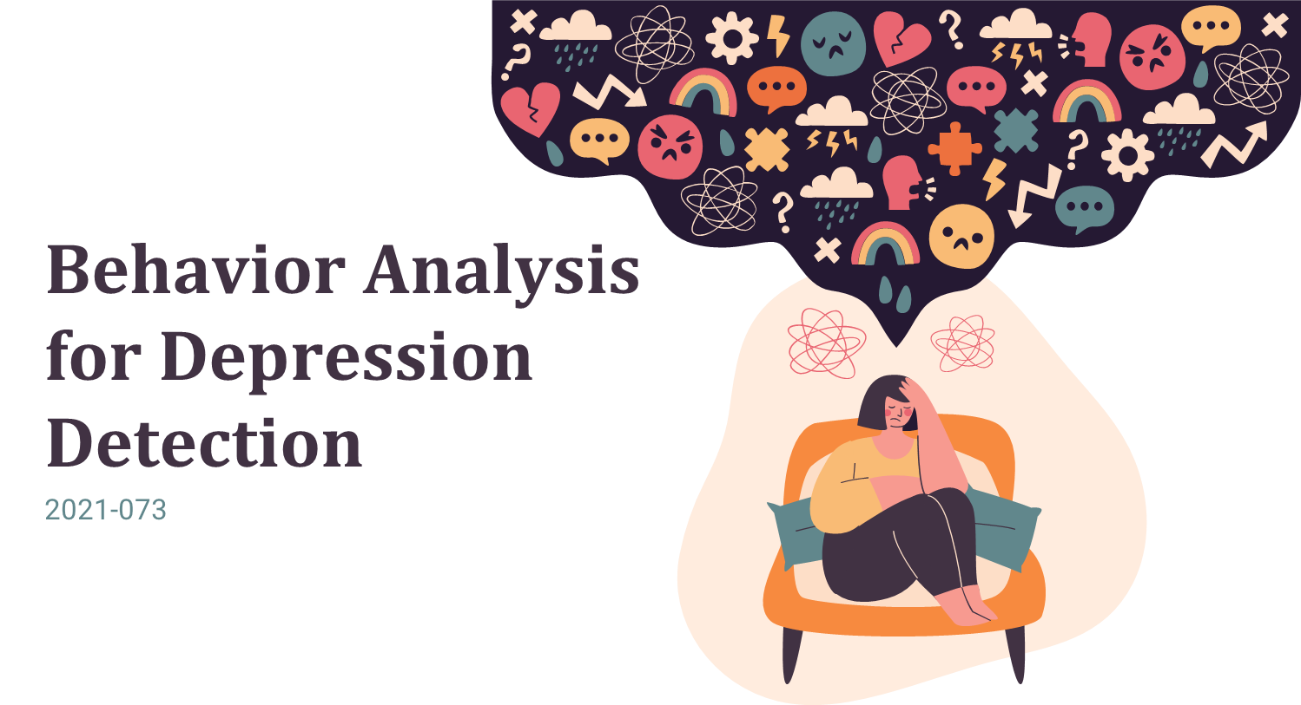


Slide 2


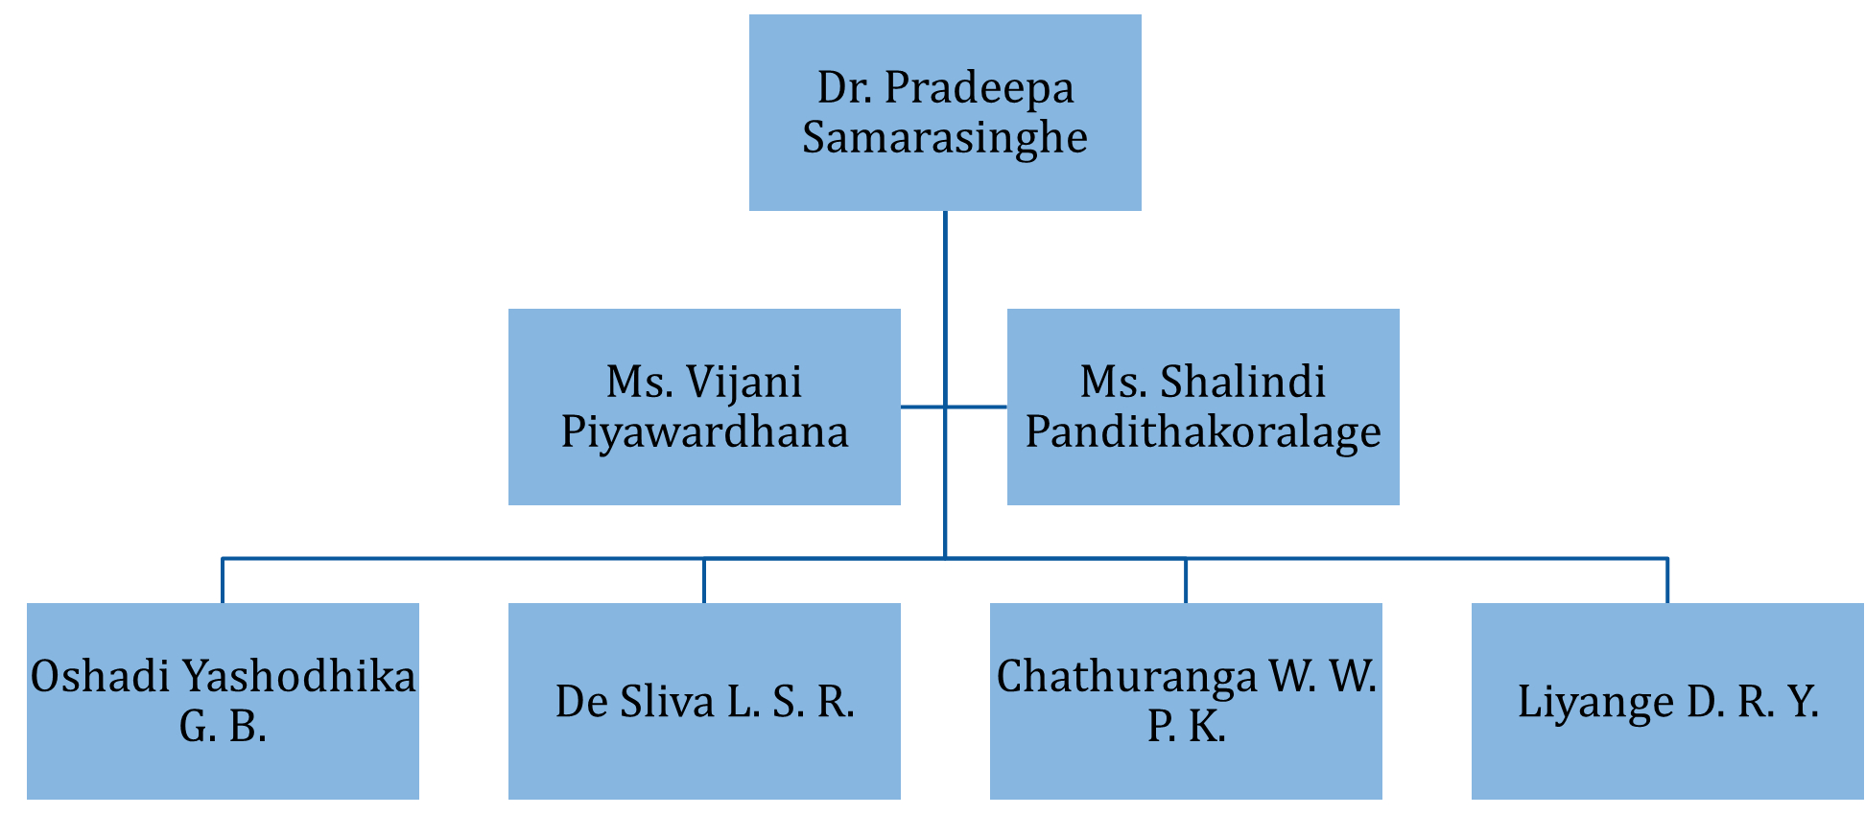

OUR TEAM

Slide 3

Depression ?
A recurrent mental disorder affecting more than 264 million people worldwide (World Health Organization).
Globally, depression has become the most common reason for illness and disability among adolescents
Early signs of severe depression are necessary to identify and ensure the affected person obtains immediate medical assistant.

Slide 4
Depression? (Cont’d)
Psychotherapy determines depression levels based on verbal reports that may bias the diverse aspects of individuals.
Currently, the mobile applications associated with depression use standard questionnaires and self assessment reports to evaluate the depression level.

Slide 5

Research Question
Why has depression become the most critical disorder?
People are not receiving adequate treatments, which may lead to suicide.
What is the main reason people tending to avoid treatment for depression in Sri Lanka?
In Sri Lanka, people may obscure the state of their minds due to social stigma and fear.

Slide 6
Research Question (Cont.’d)
What is the primary concern of mental health providers?
Mental health providers have problems with monitoring of individuals for two weeks.
Why the industry need an automate solution to assess the depression?
Periodic assessment based on structured or unstructured clinical interviews may bias the different aspects of individuals.

Slide 7

Objectives
Emotion-based behavior analysis for early identification of depressive disorder.
social media content analysis for early identification of depressive disorder.
Develop a mobile application to identify behaviors that could be highly anticipated to contribute in depressive disorder.
Acquire invasive and non-invasive data analysis for early identification of depressive disorder.
Obtain phone activity usage data analysis for early identification of depressive disorder.

Slide 8
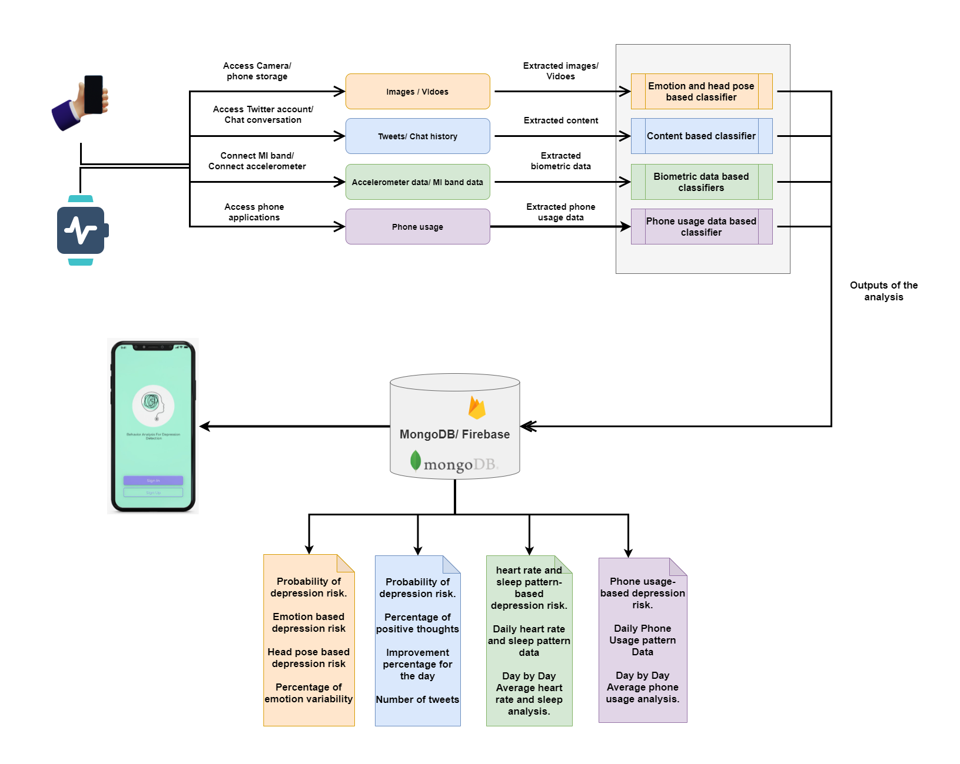
Overall System Diagram

Slide 9


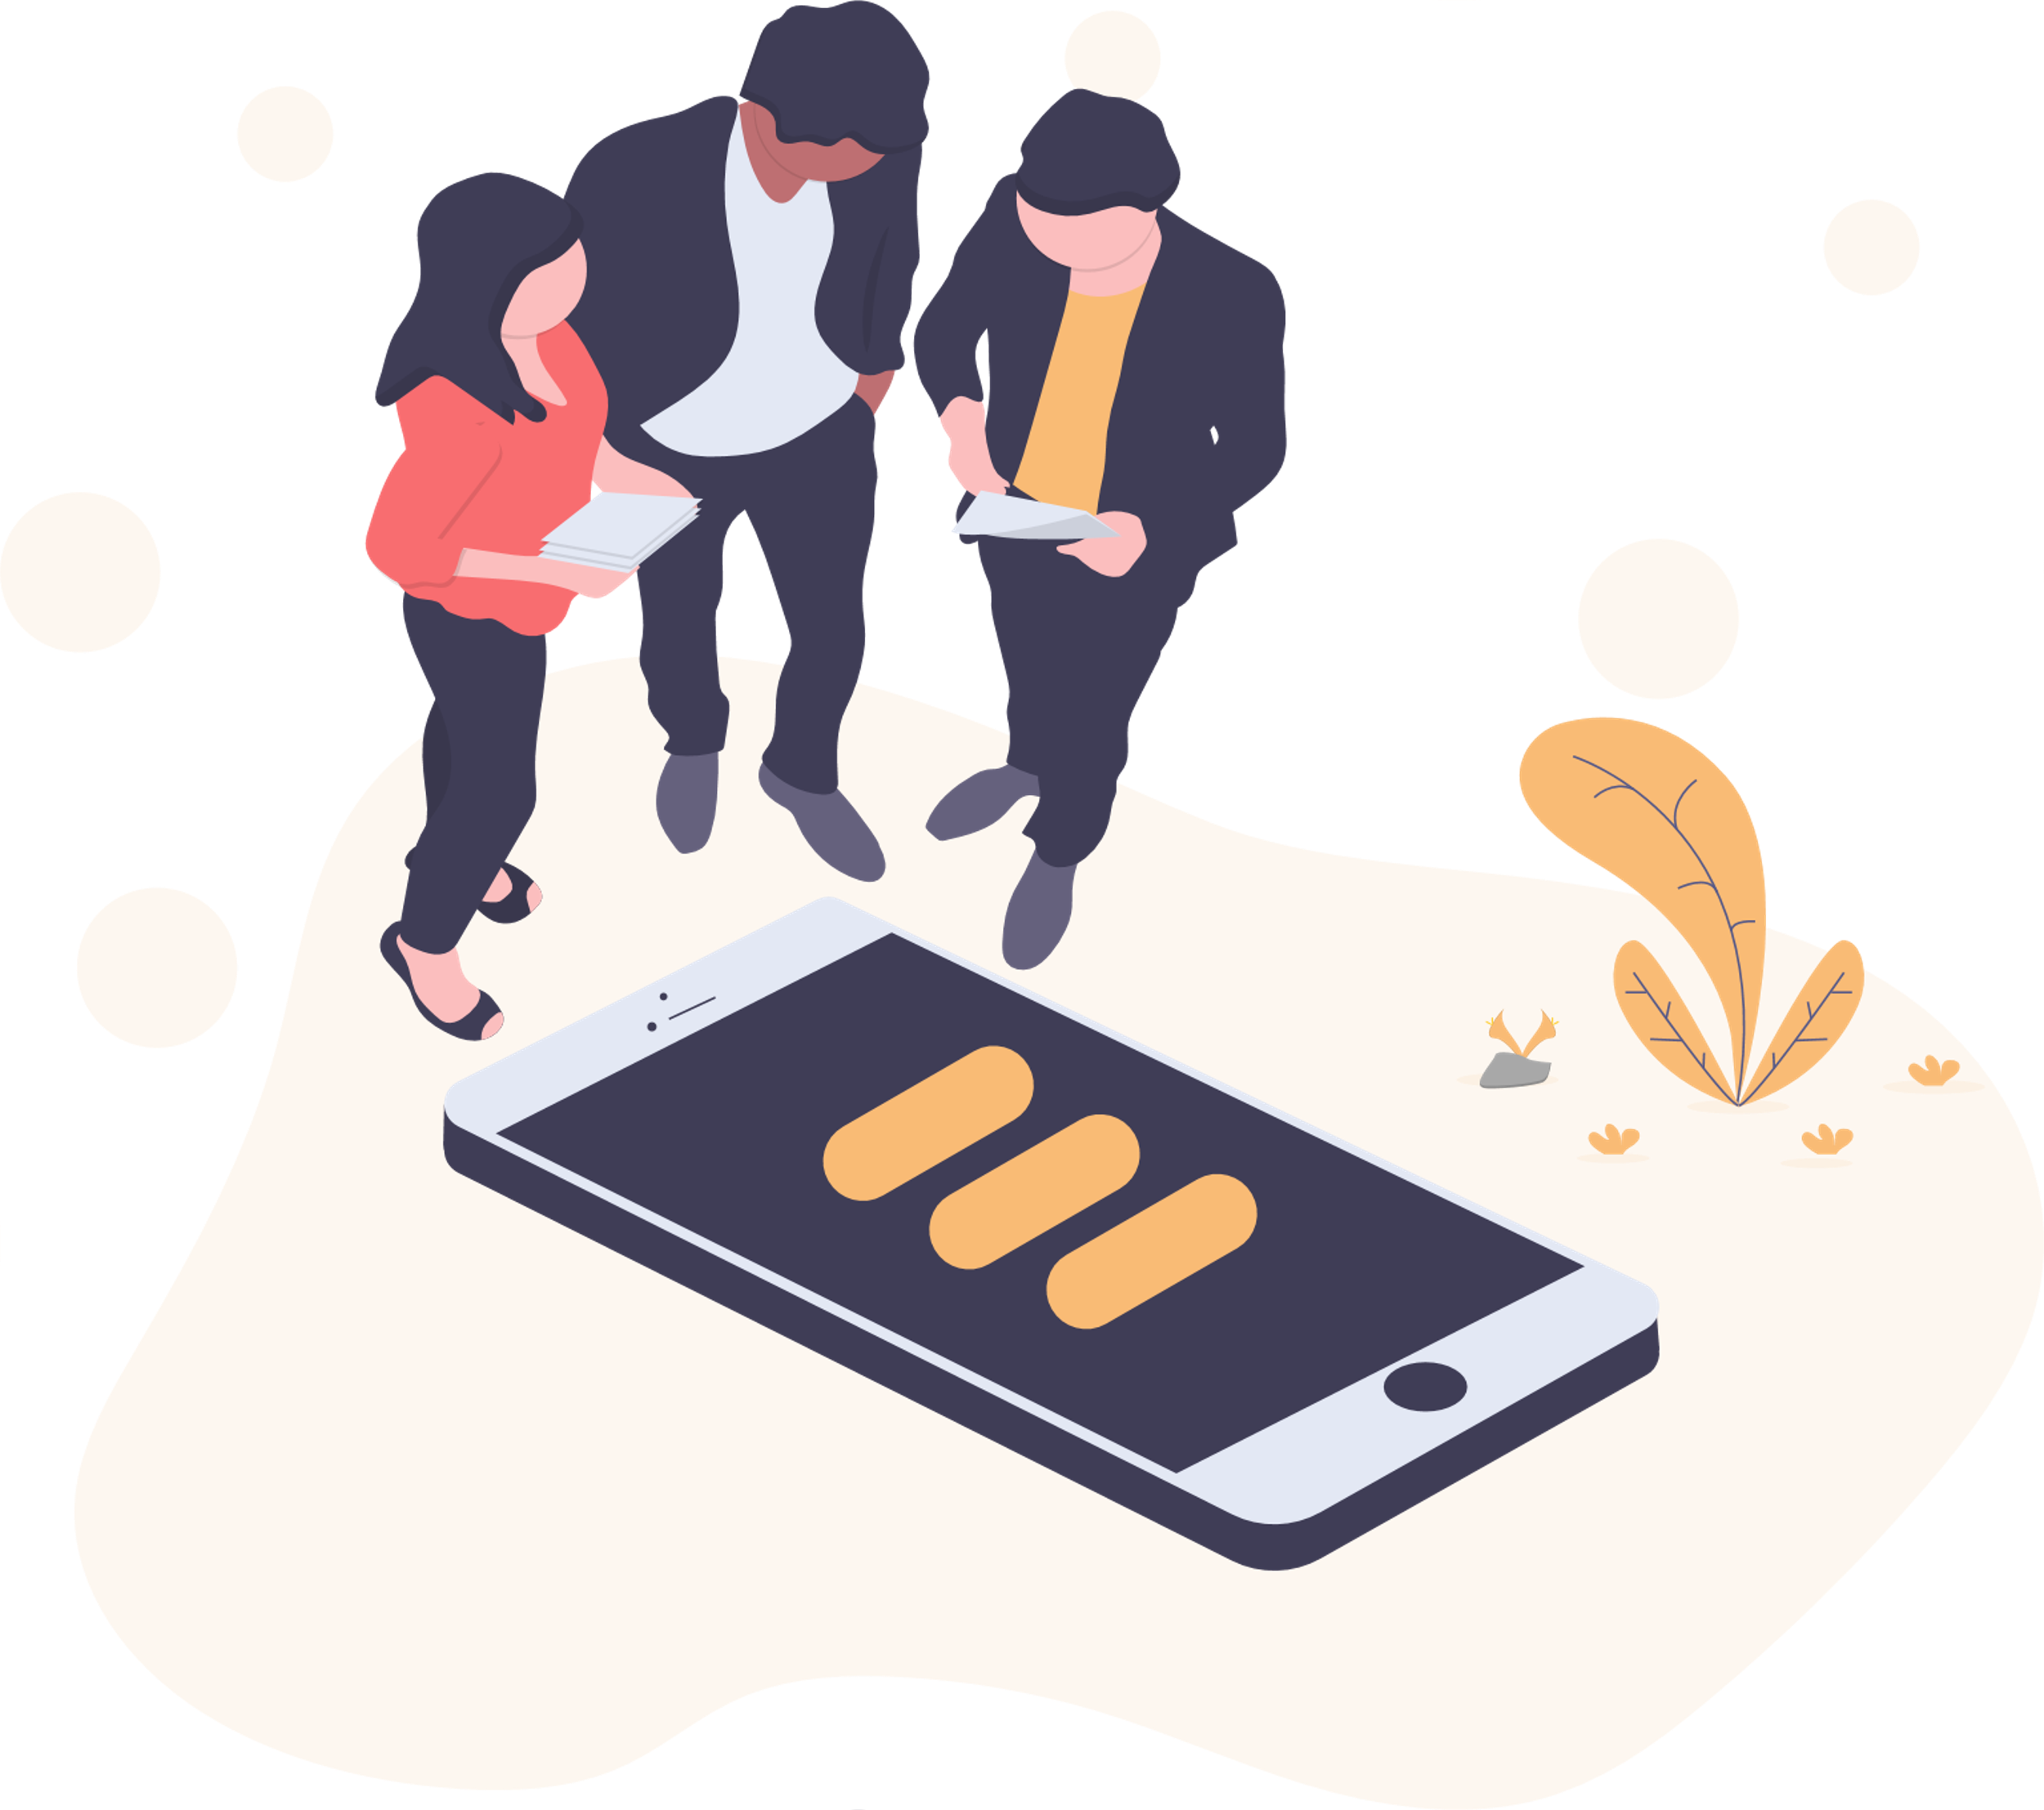





Technologies, Techniques, Algorithms
Mobile App Development
Flutter
Dart
Development Language
Python
Database
Firebase
MongoDB
Environment / IDE
Anaconda 3
Visual Studio Code
Spyder
Android Studio

Slide 10
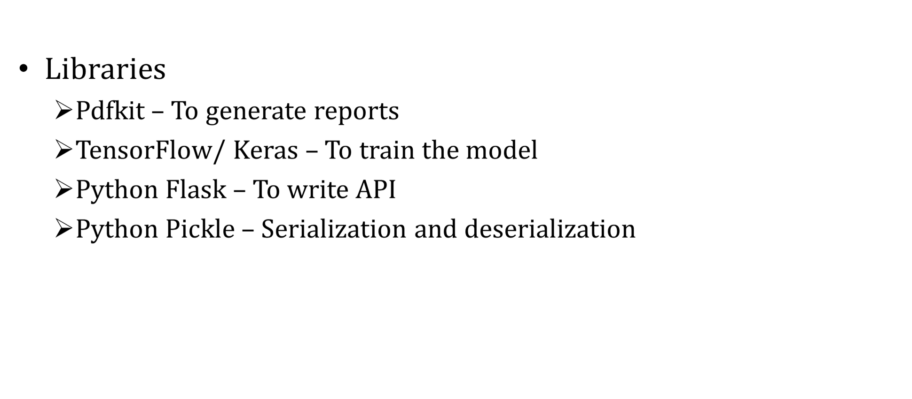
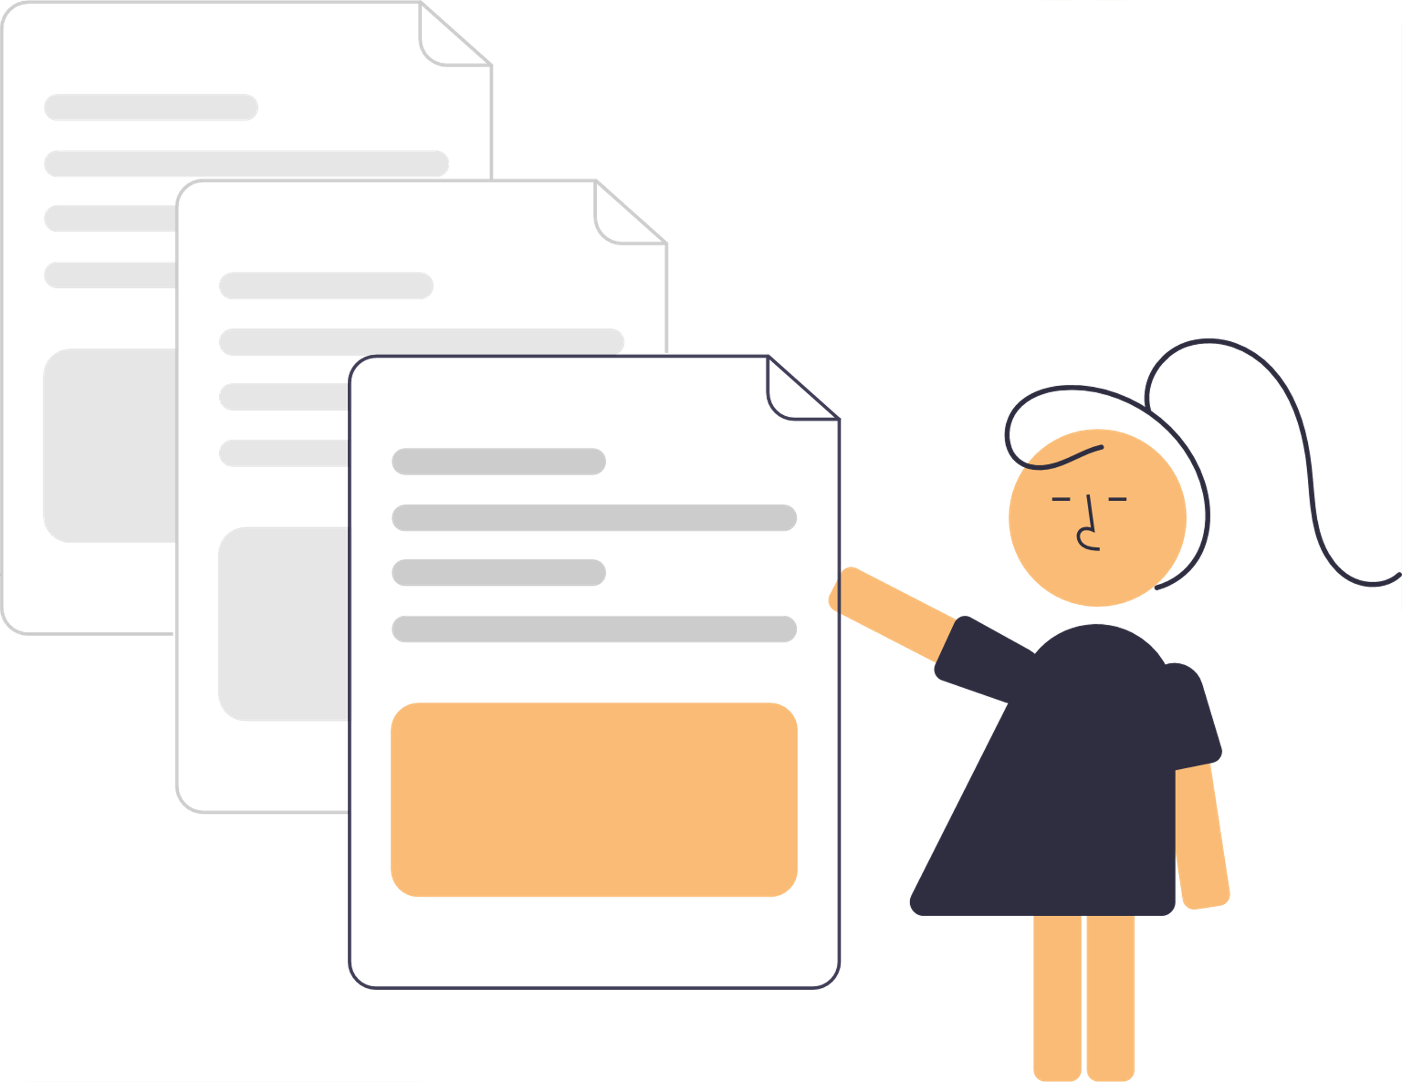
Technologies, Techniques, Algorithms (Cont’d)

Slide 11
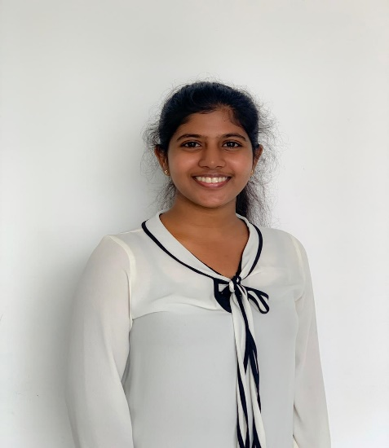

It18120226 | Oshadi Yashodhika g. b.
Information Technology
IT18120226 | Oshadi Yashodhika G. B. | 2021-073

Slide 12

EMOTION-BASED BEHAVIOR ANALYSIS FOR EARLY IDENTIFICATION OF DEPRESSIVE DISORDER
Research Question
Specific and Sub Objectives
Evidences for the Completion
IT18120226 | Oshadi Yashodhika G. B. | 2021-073

Slide 13
Research Question
Lack the automated solution to identify early depression risk using facial expression.
Lack the automated mechanism to identify head movement patterns of a depressed individual.
Behavior monitoring of individuals for two weeks is difficult.
Individuals do not attend counseling sessions due to social stigma.
IT18120226 | Oshadi Yashodhika G. B. | 2021-073

Slide 14
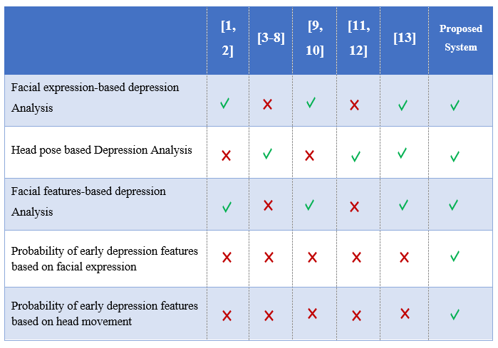
Research Gap
IT18120226 | Oshadi Yashodhika G. B. | 2021-073

Slide 15
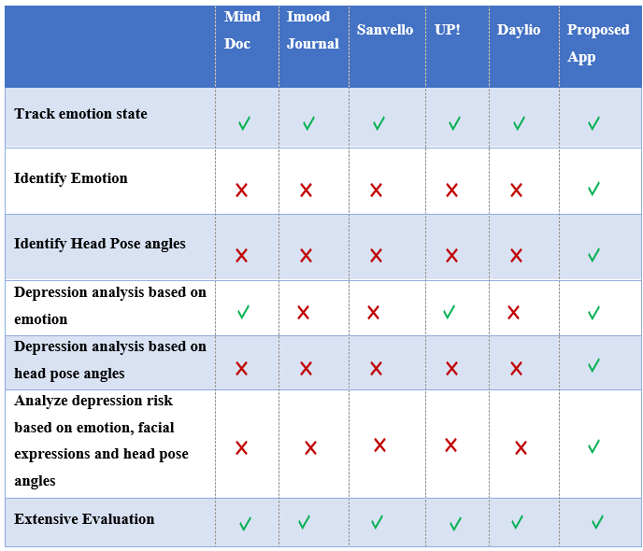
Mobile Application Gap
IT18120226 | Oshadi Yashodhika G. B. | 2021-073

Slide 16

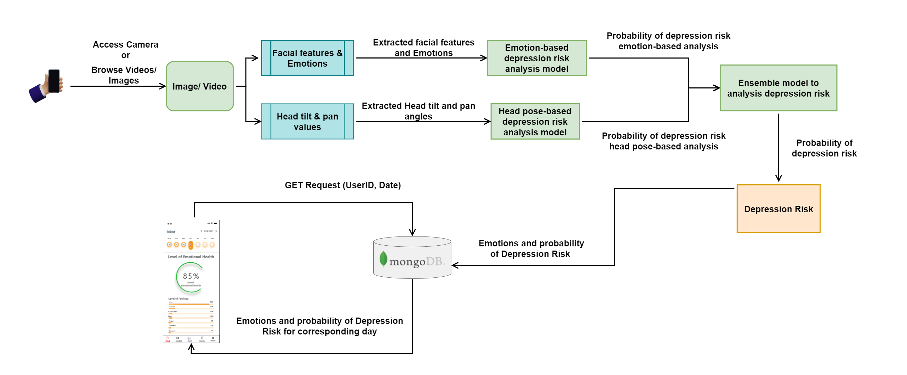
System Overview
IT18120226 | Oshadi Yashodhika G. B. | 2021-073

Slide 17



Specific and Sub Objectives
Specific Objective
Emotion-based behavior analysis for early identification of depressive disorder
Sub Objectives
Create datasets to retrieve facial emotions of depressed/likely depressed individuals.
Identify emotions of depressed/likely depressed individuals based on images and videos.
Improving the existing methods to capture subtle emotional changes.
Identify head movements pattern of depressed/likely depressed individuals based on videos.
Build a classifier to model, abnormal behaviors based on facial emotions and head movements.
Predict the probability of abnormal behavior towards depression with the designed model.
Integrate the classifier to Mobile Application.
IT18120226 | Oshadi Yashodhika G. B. | 2021-073

Slide 18
Implementation Progress
Data Collection
Data Analysis
Model Implementation and Testing
Mobile App
Implementation
Model Integration with Mobile App
Complete Mobile App
Depression Dataset
Non-Depression Dataset
Data Labeling
Feature Extraction
Emotion Based Model
Head Posture Based Model
Ensemble Model
Interface
Design
Functionality Implementation
Interface Implementation
Completed (PP1)
API Implementation
Pipeline Implementation
Completed (PP2)
To be Completed (Final)
Model Deployment
Integrate Application
IT18120226 | Oshadi Yashodhika G. B. | 2021-073

Slide 19
Data Collection
YouTube Videos of Psychiatric Interviews with Depressed individuals.
YouTube Channel - Pika Grape Snack/ University of Nottingham/ Symptom Media
Videos - 09
YouTube Videos about True Depression Recovery Stories U.S. Army Officers.
YouTube Channel - Make the Connection
Videos - 09
IT18120226 | Oshadi Yashodhika G. B. | 2021-073

Slide 20
Data Analysis – Data Labeling
Videos were separated into frames.
Each separated video frame was labelled with the help of external supervisor, Ms. Shalindi Pandithkoralage.
Video Frames were labelled as depressed images and non-depressed images.
Depressed Individuals – 15
Video Frames – 1,322
Non-depressed Individuals – 12
Video Frames – 1,747
IT18120226 | Oshadi Yashodhika G. B. | 2021-073

Slide 21
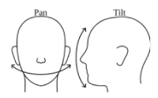
Data Analysis – Feature Extraction
Affectiva JavaScript API was used to extract facial features [14].
One of the leaders in emotion recognition technology.
Free Version
Pre-defined model, RealHePoNet was used for Head Pose Estimation [15].
Estimation of vertical(tilt/pitch) and horizontal (pan/yaw) angles.
Accuracy → 97% (Pointing’04 Dataset)
91% (Annotated Facial Landmarks in the Wild Dataset)
IT18120226 | Oshadi Yashodhika G. B. | 2021-073

Slide 22
Model Implementation
Emotion-based depression Risk Analysis.
Test Accuracy – 81%
Head pose-based depression Risk Analysis.
Test Accuracy – 79%
Ensembled classifier for depression Risk Analysis.
Test Accuracy – 83%
IT18120226 | Oshadi Yashodhika G. B. | 2021-073

Slide 23
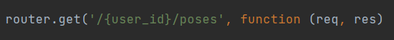
API Implementation
Express JS and Node JS is used to implement the RESTful API.
POST method – Store emotions and probability of depression risk
GET method – Access the stored data based on date and User
IT18120226 | Oshadi Yashodhika G. B. | 2021-073

Slide 24
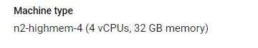
Service Deployment
Google Cloud Platform is a suite of cloud computing services.
The service is deployed in Google cloud.
The service is run on a virtual machine with 4 virtual CPUs and 32 GB memory.
OS image used in the virtual machine is ubuntu with the size of 50 GB.
IT18120226 | Oshadi Yashodhika G. B. | 2021-073

Slide 25
Mobile Implementation
Access phone camera or browse the files on the mobile for videos and images.
IT18120226 | Oshadi Yashodhika G. B. | 2021-073

Slide 26
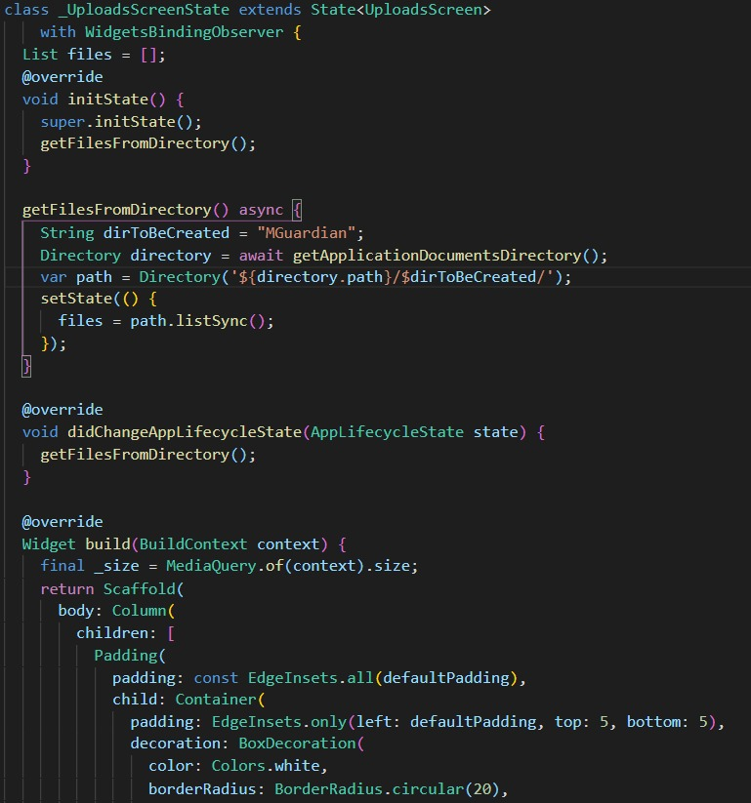
Mobile Implementation – Cont’d
Uploaded files will only save in local storage.
IT18120226 | Oshadi Yashodhika G. B. | 2021-073

Slide 27
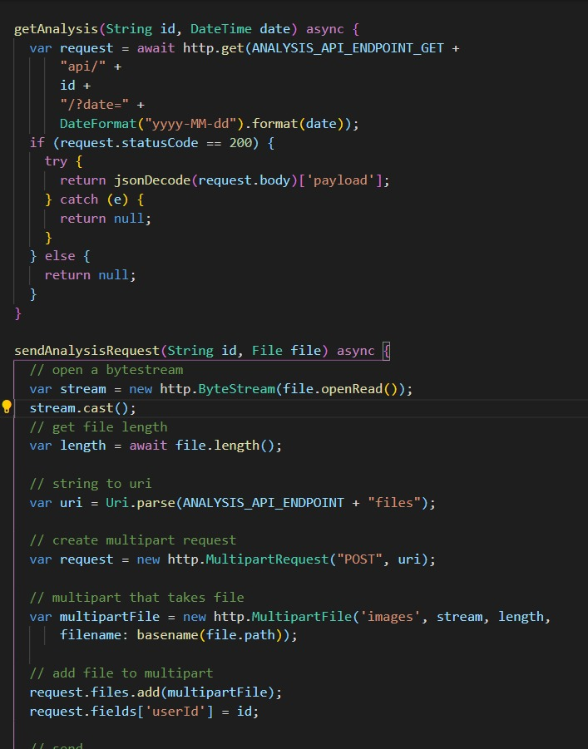
Mobile Implementation – Cont’d
API request is triggered once the image or video is uploaded from the mobile.
IT18120226 | Oshadi Yashodhika G. B. | 2021-073

Slide 28
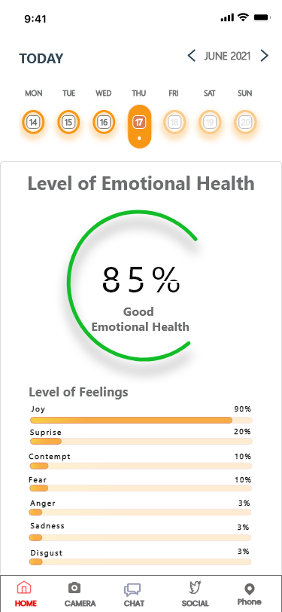
Mobile Implementation – Cont’d
Detailed summary will be
displayed to user.
IT18120226 | Oshadi Yashodhika G. B. | 2021-073

Slide 29

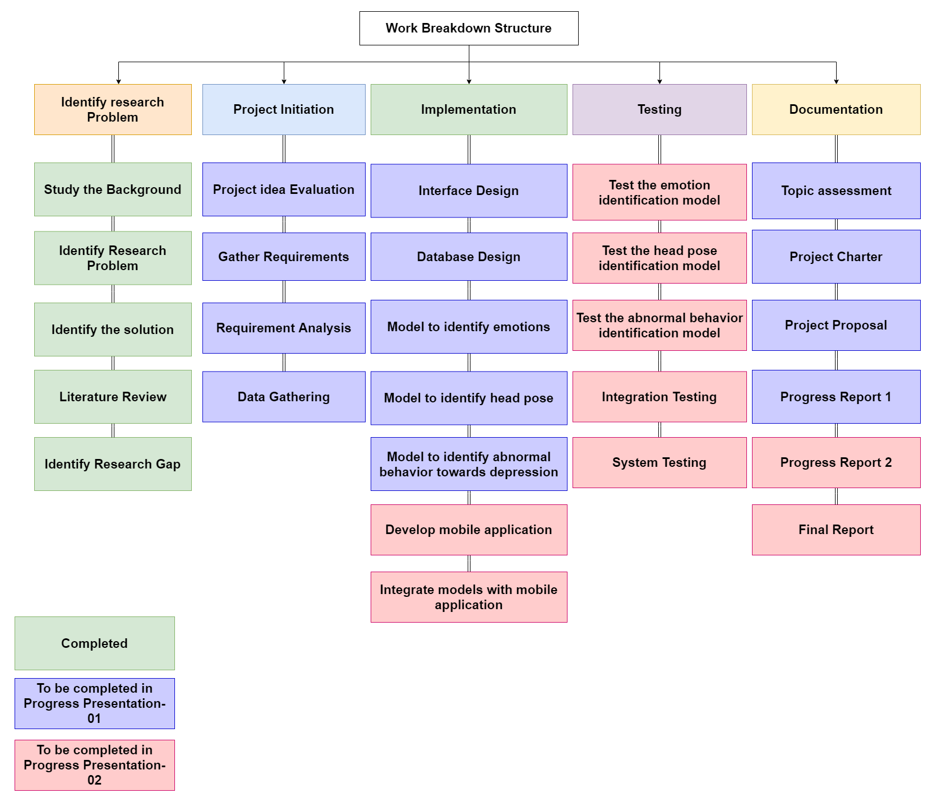
Work Breakdown Structure
IT18120226 | Oshadi Yashodhika G. B. | 2021-073

Slide 30
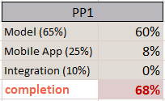
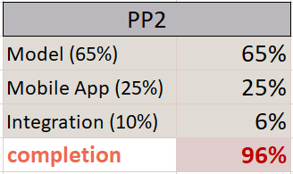
Individual Progress
→ Model Implementation.
→ Mobile App Implementation.
→ Individual components Integration.
Progress To Be
→ System Integration.
Current Progress
IT18120226 | Oshadi Yashodhika G. B. | 2021-073

Slide 31
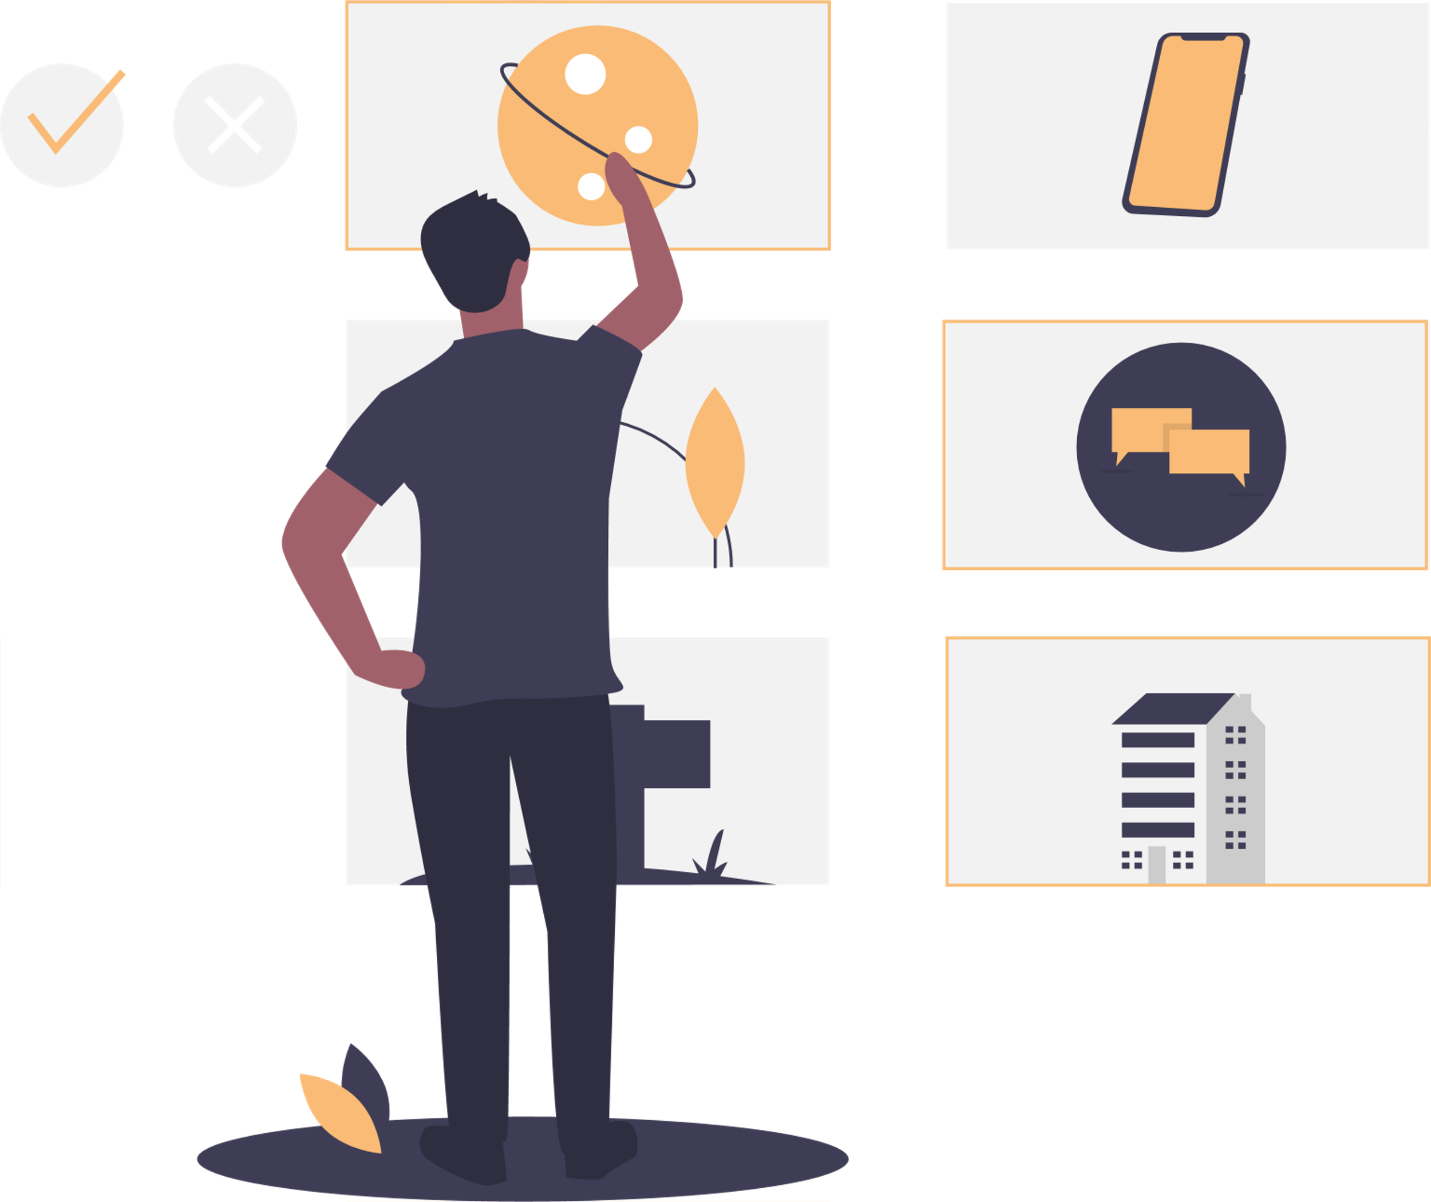
References
[1] World Health Organization, “Depression,” World Health Organization. [Online]. Available: https://www.who.int/health-topics/depression. [Accessed: 10-Oct-2021].
[2] ] W. C. de Melo, E. Granger and A. Hadid, "Combining Global and Local Convolutional 3D Networks for Detecting Depression from Facial Expressions," 2019 14th IEEE International Conference on Automatic Face & Gesture Recognition (FG 2019), 2019, pp. 1-8, doi: 10.1109/FG.2019.8756568.
[3] W. Carneiro de Melo, E. Granger and M. B. Lopez, "Encoding Temporal Information For Automatic Depression Recognition From Facial Analysis," ICASSP 2020 - 2020 IEEE International Conference on Acoustics, Speech and Signal Processing (ICASSP), 2020, pp. 1080-1084, doi: 10.1109/ICASSP40776.2020.9054375.
[4] ] W. Carneiro de Melo, E. Granger and M. Bordallo Lopez, "MDN: A Deep Maximization-Differentiation Network for Spatio-Temporal Depression Detection," in IEEE Transactions on Affective Computing, doi: 10.1109/TAFFC.2021.3072579.
[5] B. Vimaleswaran and G. S. Ratnayake, "E - Therapy Improvement Monitoring Platform for Depression using Facial Emotion Detection of Youth," 2021 35 Third International Conference on Intelligent Communication Technologies and Virtual Mobile Networks (ICICV), 2021, pp. 950-955, doi: 10.1109/ICICV50876.2021.9388447.
[6] ] X. Li, W. Guo and H. Yang, "Depression severity prediction from facial expression based on the DRR_DepressionNet network," 2020 IEEE International Conference on Bioinformatics and Biomedicine (BIBM), 2020, pp. 2757-2764, doi: 10.1109/BIBM49941.2020.9313597.
[7] A. Mulay, A. Dhekne, R. Wani, S. Kadam, P. Deshpande and P. Deshpande, "Automatic Depression Level Detection Through Visual Input," 2020 Fourth World Conference on Smart Trends in Systems, Security and Sustainability (WorldS4), 2020, pp. 19-22, doi: 10.1109/WorldS450073.2020.9210301.
[8] L. Yang, D. Jiang, W. Han and H. Sahli, "DCNN and DNN based multi-modal depression recognition," 2017 Seventh International Conference on Affective Computing and Intelligent Interaction (ACII), 2017, pp. 484-489, doi: 10.1109/ACII.2017.8273643.
IT18120226 | Oshadi Yashodhika G. B. | 2021-073

Slide 32
References
[9] S. Alghowinem, R. Goecke, J. F. Cohn, M. Wagner, G. Parker and M. Breakspear, "Cross-cultural detection of depression from nonverbal behaviour," 2015 11th IEEE International Conference and Workshops on Automatic Face and Gesture Recognition (FG), 2015, pp. 1-8, doi: 10.1109/FG.2015.7163113.
[10] J. F. Cohn et al., "Detecting depression from facial actions and vocal prosody," 2009 3rd International Conference on Affective Computing and Intelligent Interaction and Workshops, 2009, pp. 1-7, doi: 10.1109/ACII.2009.5349358.
[11] S. P. Namboodiri and Venkataraman, “A computer vision based image processing system for depression detection among students for counseling,” Indones. j. electr. eng. comput. sci., vol. 14, no. 1, p. 503, 2019. 36
[12] S. Alghowinem, R. Goecke, M. Wagner, G. Parkerx and M. Breakspear, "Head Pose and Movement Analysis as an Indicator of Depression," 2013 Humaine Association Conference on Affective Computing and Intelligent Interaction, 2013, pp. 283-288, doi: 10.1109/ACII.2013.53.
[13] J. Joshi, R. Goecke, G. Parker and M. Breakspear, "Can body expressions contribute to automatic depression analysis?," 2013 10th IEEE International Conference and Workshops on Automatic Face and Gesture Recognition (FG), 2013, pp. 1-7, doi: 10.1109/FG.2013.6553796.
[14] L. Kulke, D. Feyerabend, and A. Schacht, “A comparison of the affectiva iMotions facial expression analysis software with EMG for identifying facial expressions of emotion,” Front. Psychol., vol. 11, p. 329, 2020.
[15] R. Berral-Soler, F. J. Madrid-Cuevas, R. Muñoz-Salinas, and M. J. Marín-Jiménez, “RealHePoNet: a robust single-stage ConvNet for head pose estimation in the wild,” Neural Comput. Appl., vol. 33, no. 13, pp. 7673–7689, 2021.
IT18120226 | Oshadi Yashodhika G. B. | 2021-073

Slide 33
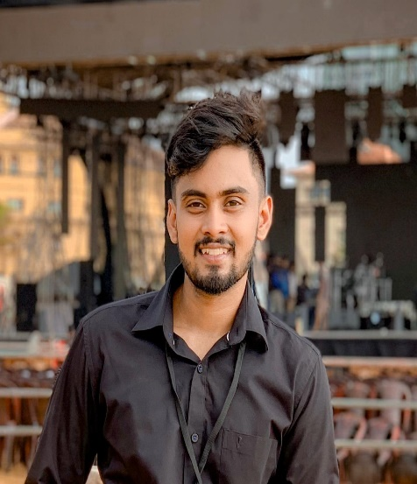
IT18113914 |De silva l. s. r
Information Technology
IT18113914 | De Silva L. S. R. | 2021-073

Slide 34

SOCIAL MEDIA CONTENT ANALYSIS FOR EARLY IDENTIFICATION OF DEPRESSIVE DISORDER
Research Question
Specific and Sub Objectives
Evidences for the Completion
IT18113914 | De Silva L. S. R. | 2021-073

Slide 35
Research Question
Difficult to monitor individuals manually for two weeks.
Lack the automated solution to identify early depression risk using Social media platform.
Lack the automated solution to analyze conversations to identify early depression risk.
Social stigma hinders individuals for attending counseling sessions.
IT18113914 | De Silva L. S. R. | 2021-073

Slide 36
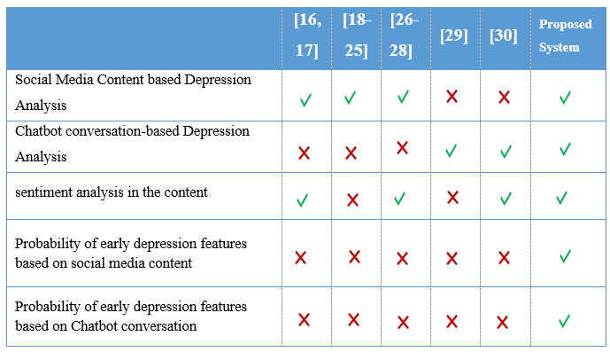
Research Gap
IT18113914 | De Silva L. S. R. | 2021-073

Slide 37
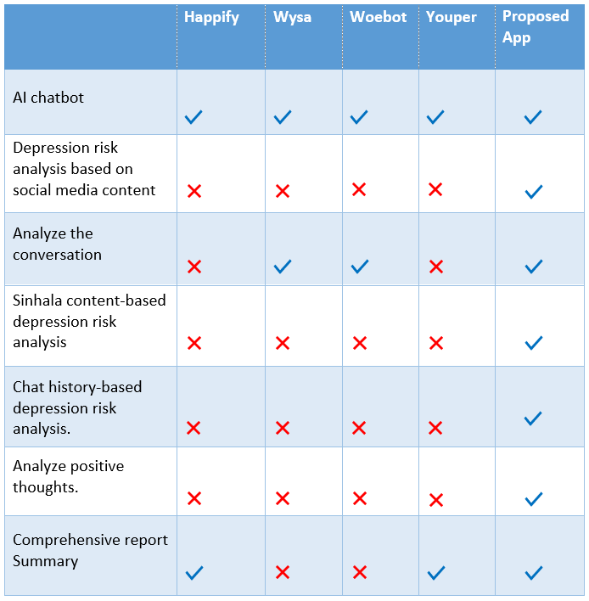
Mobile Application Gap
IT18113914 | De Silva L. S. R. | 2021-073

Slide 38
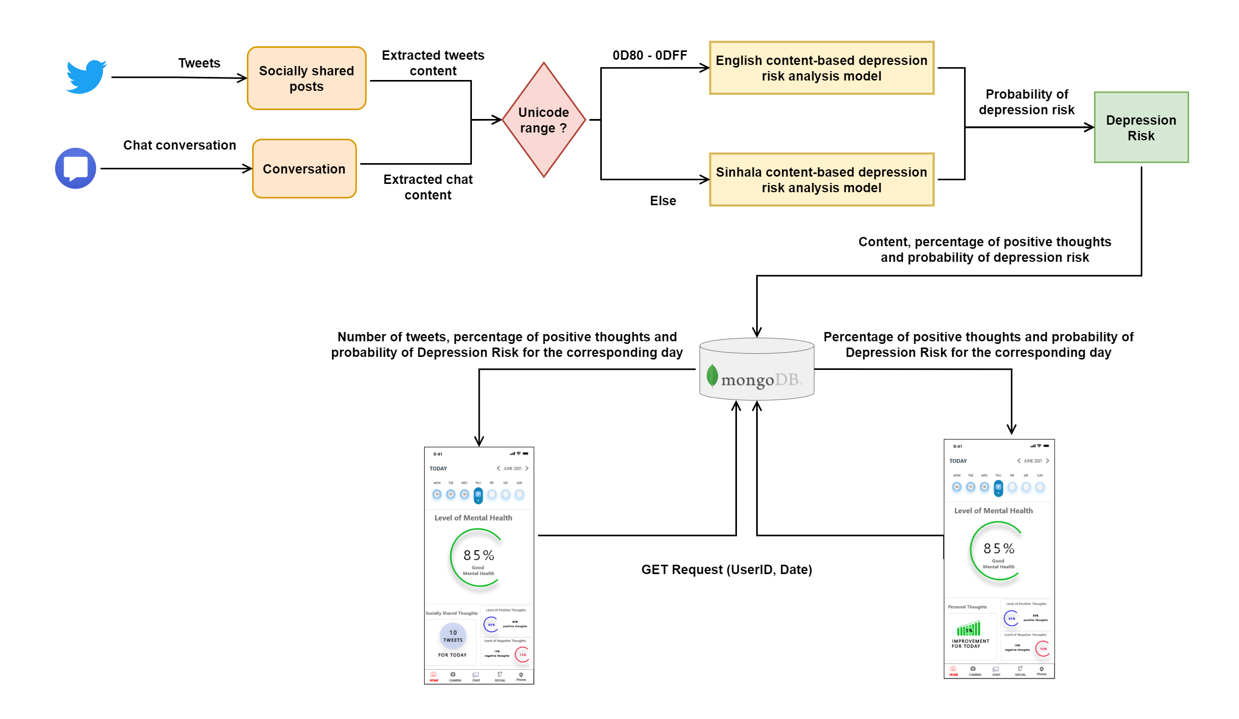
System Overview
IT18120226 | Oshadi Yashodhika G. B. | 2021-073

Slide 39
Specific and Sub Objectives
Specific Objective
Social media content analysis for early identification of depressive disorder
Sub Objectives
Build a database based on Social Media Content.
Identify social media texting patterns based on the built database.
Build a classifier to model, abnormal social activities based on social media content.
Predict the probability of abnormal social activities towards depression with the designed model.
Design and implement ChatBot to initiate conversations, identify depressive thoughts based on conversations.
IT18113914 | De Silva L. S. R. | 2021-073

Slide 40
Implementation Progress
Data Collection
Data Analysis
Model Implementation and Testing
Mobile App
Implementation
Model Integration with Mobile App
Complete Mobile App
Social Media Content Dataset
Chatbot Conversation Dataset
Translation
Word Embedding
English Model
Sinhala Model
ChatBot Model
Interface
Design
Functionality Implementation
Interface Implementation
Completed (PP1)
API Implementation
Pipeline Implementation
Completed (PP2)
To be Completed (Final)
Model Deployment
Integrate Application
IT18113914 | De Silva L. S. R. | 2021-073

Slide 41
Data Collection
Russian Dataset of Depressive Posts collected from Social Media [31].
Public Accounts of Vkontakte Social Network from Commonwealth of Independent States (CIS) Countries.
The collected data was classified by psychologists.
32 018 depressive posts
32 021 non-depressive posts.
Dataset for ChatBot was obtained from DAIC-WOZ database [32].
Wizard-of-Oz interviews, conducted by an animated virtual interviewer (Ellie)
Controlled by a human interviewer in another room.
Designed to support the diagnosis of psychological distress conditions.
Interview Sessions – 189 Sessions
IT18113914 | De Silva L. S. R. | 2021-073

Slide 42
Data Analysis – Translation
Translate Russian Language to English Language
Pre-defined model, MarianMT Transformers was used to translate dataset into English Language [33].
Translate Russian Language to Sinhala Language
Google Translator used to translate dataset into Sinhala Language.
IT18113914 | De Silva L. S. R. | 2021-073

Slide 43
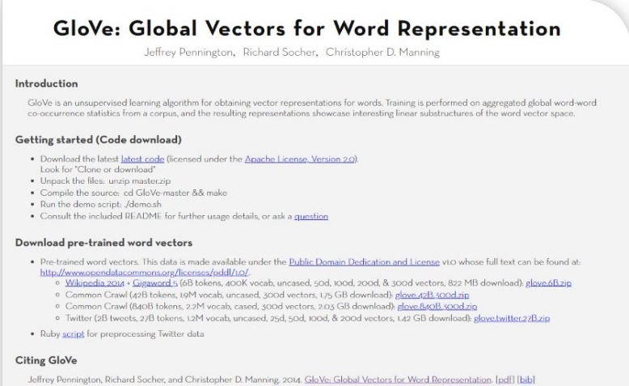
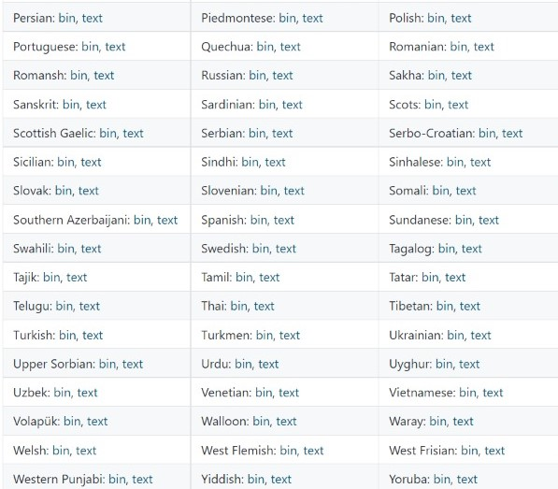
Data Analysis – Word Embedding
Word Embedding for English Content [34].
GloVe Vector Model
Developed by Stanford University.
Ssupports for FastText Model .
Word Embedding for Sinhala Content [35].
Sinhalese Vector Model
Developed by Facebook's AI Research lab.
IT18113914 | De Silva L. S. R. | 2021-073

Slide 44
Model Implementation
English content-based depression risk analysis.
Test Accuracy – 96%
Sinhala content-based depression risk analysis.
Test Accuracy – 95%
Chatbot classifier for depression Risk Analysis.
Test Accuracy – 83%
IT18113914 | De Silva L. S. R. | 2021-073

Slide 45
ChatBot Implementation
Rasa Framework is used in ChatBot Implementation.
Rasa is an Open-Source Conversational AI to build contextual AI Assistant and Chatbots.
IT18113914 | De Silva L. S. R. | 2021-073

Slide 46
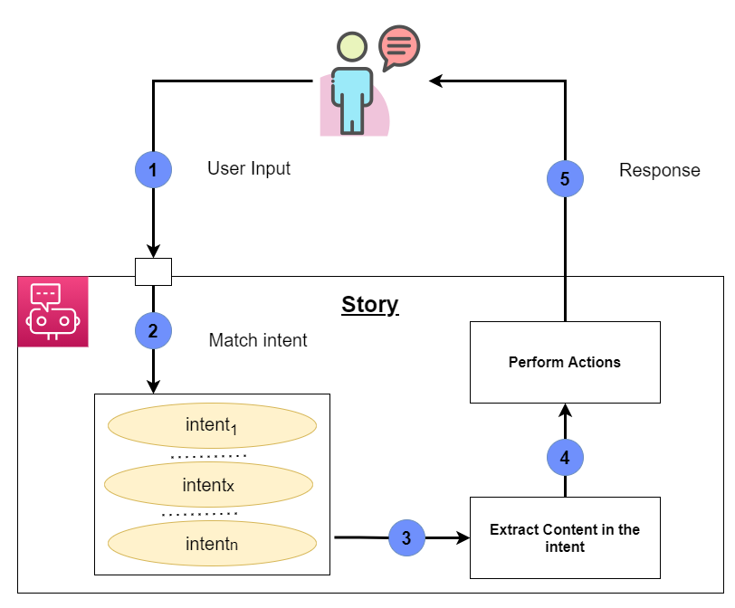
ChatBot – Cont’d
Intent – Define Possible User Inputs
Action – Response
Entity – Extract Information
Stories – Define the Flow
IT18113914 | De Silva L. S. R. | 2021-073

Slide 47
API Implementation
FastAPI is used to implement the RESTful API.
POST method – Store percentage of positive thoughts and probability of depression risk
GET method – Access the stored data based on date and User
IT18113914 | De Silva L. S. R. | 2021-073

Slide 48
Service Deployment
Google Cloud Platform is a suite of cloud computing services.
The service is deployed in Google cloud.
The service is run on a virtual machine with 4 virtual CPUs and 32 GB memory.
OS image used in the virtual machine is ubuntu with the size of 50 GB.
IT18113914 | De Silva L. S. R. | 2021-073

Slide 49
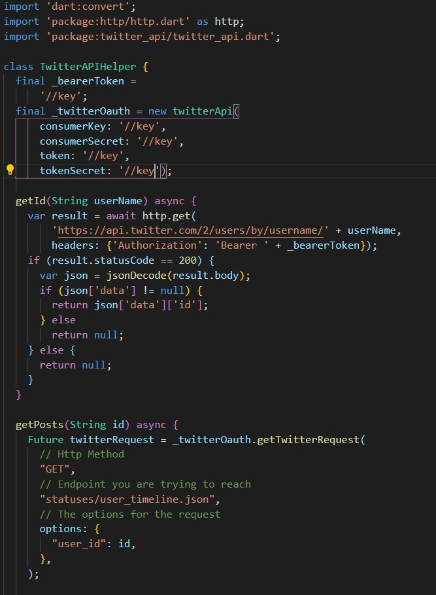
Mobile Implementation
Initialize the Twitter API
Access user accounts through twitter API
Access Twitter posts through twitter API
IT18113914 | De Silva L. S. R. | 2021-073

Slide 50
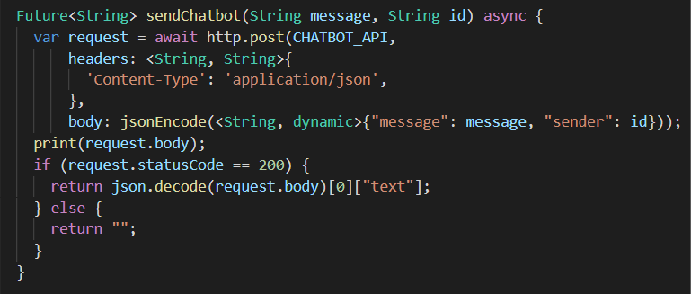
Mobile Implementation – Cont’d
The chatbot is connected with the application.
IT18113914 | De Silva L. S. R. | 2021-073

Slide 51
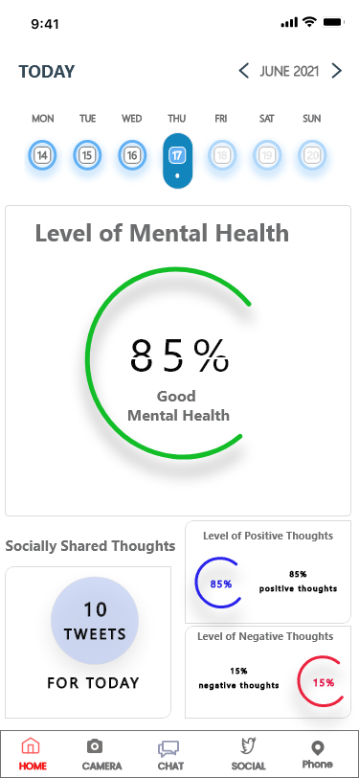
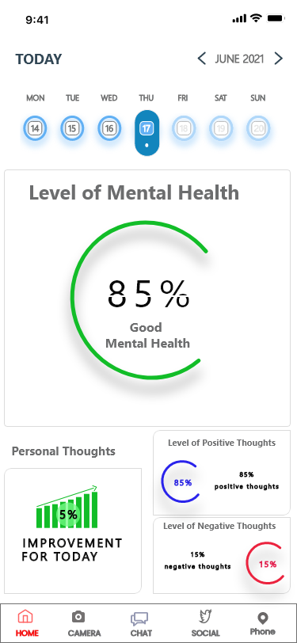
Mobile Implementation – Cont’d
Detailed summary will be
displayed to user.
IT18113914 | De Silva L. S. R. | 2021-073

Slide 52
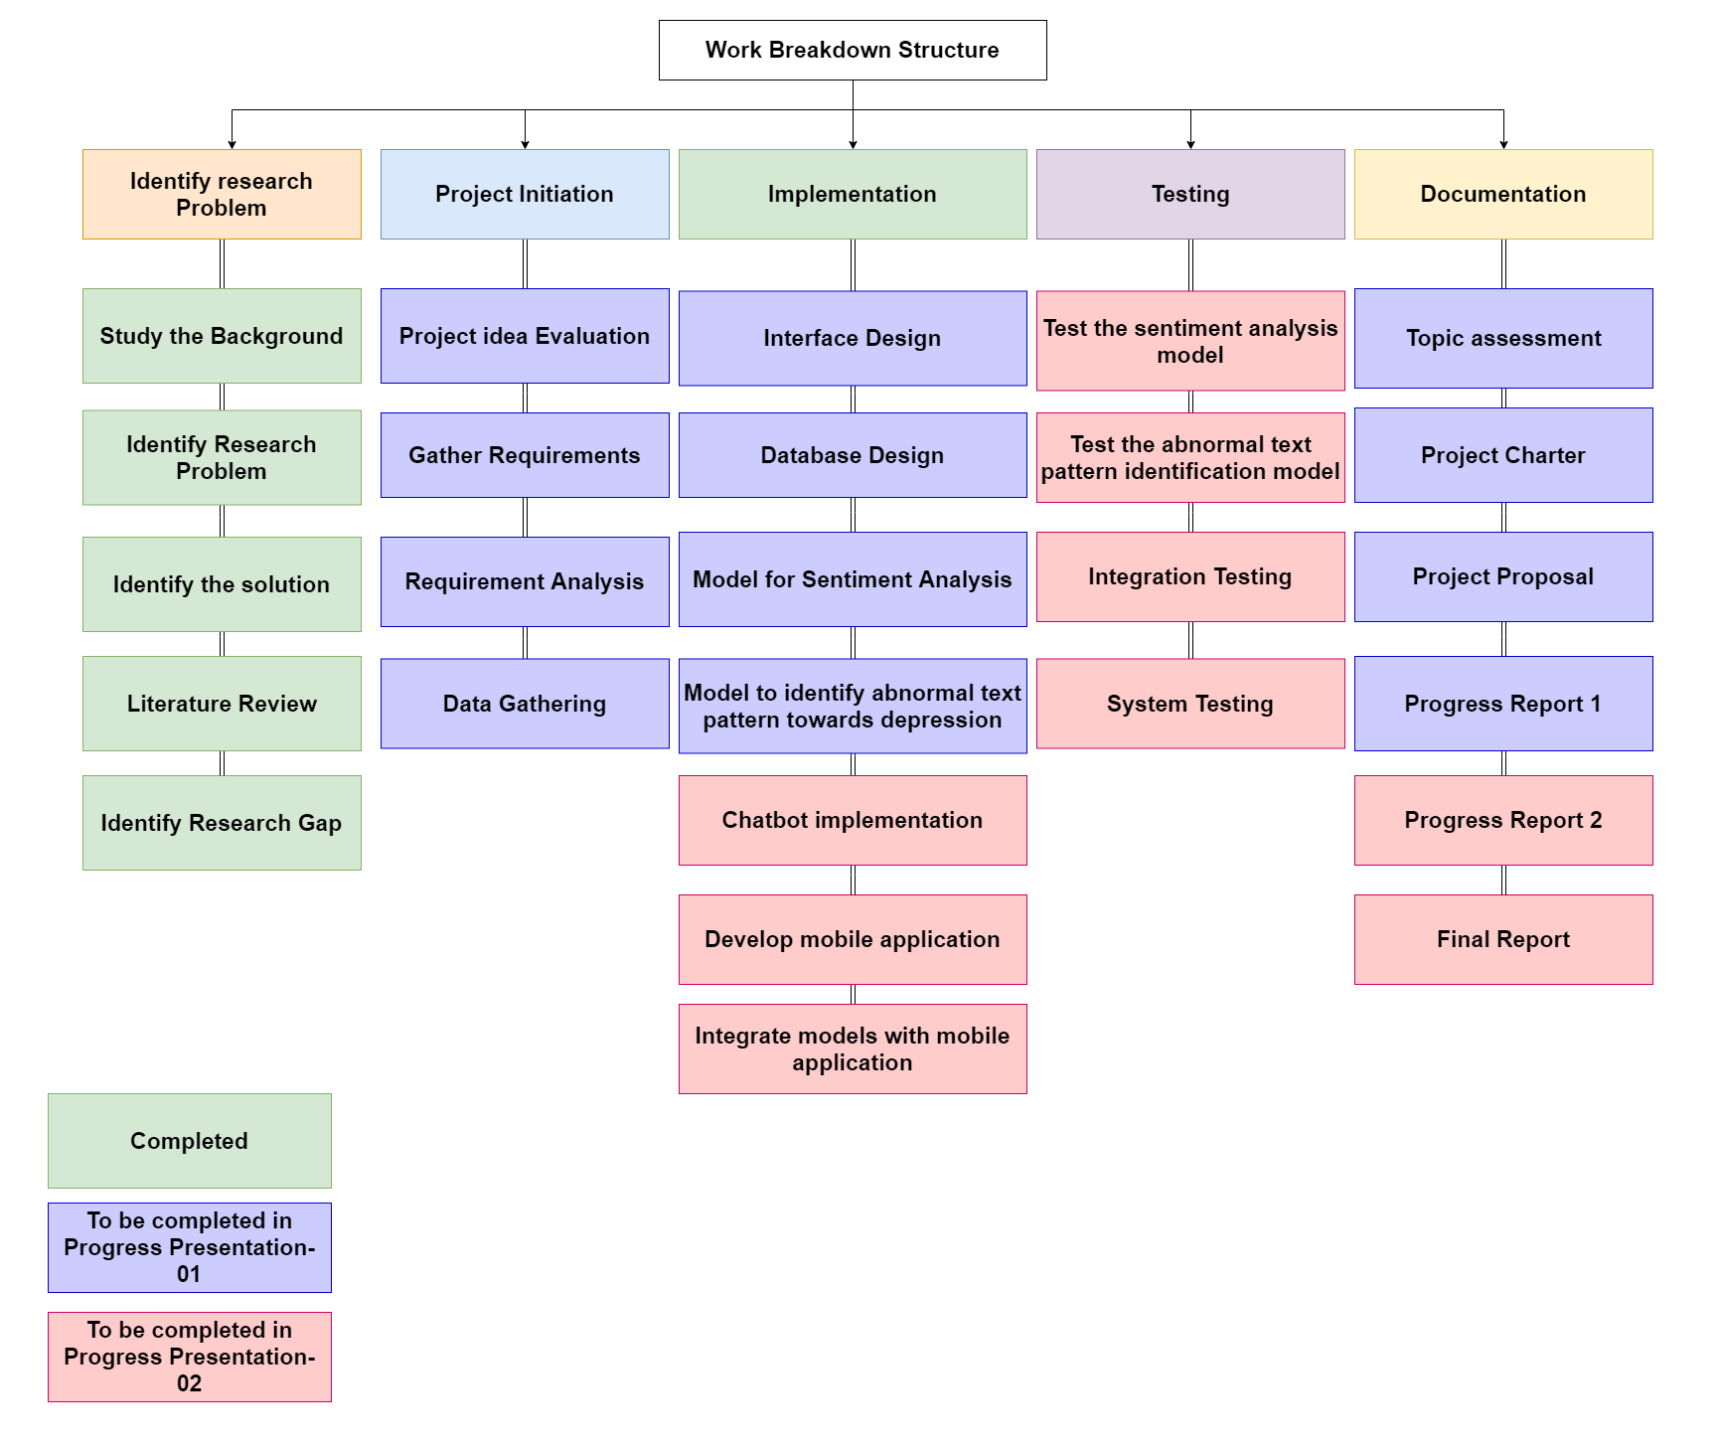
Work Breakdown Structure
IT18113914 | De Silva L. S. R. | 2021-073

Slide 53
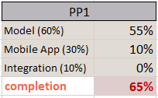
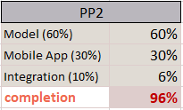
Individual Progress
→ Model Implementation.
Progress To Be
→ System Integration.
→ Mobile App Implementation.
→ Individual Mobile App Integration.
Current Progress
IT18113914 | De Silva L. S. R. | 2021-073

Slide 54
References
[16] K. A. Govindasamy and N. Palanichamy, "Depression Detection Using Machine Learning Techniques on Twitter Data," 2021 5th International Conference on Intelligent Computing and Control Systems (ICICCS), 2021, pp. 960-966, doi: 10.1109/ICICCS51141.2021.9432203.
[17] S. Ghosh and T. Anwar, "Depression Intensity Estimation via Social Media: A Deep Learning Approach," in IEEE Transactions on Computational Social Systems, doi: 10.1109/TCSS.2021.3084154.
[18] a Deep Learning Approach for Depression Detection in Imbalanced Data," 2018 IEEE International Conference on Bioinformatics and Biomedicine (BIBM), 2018, pp. 1624-1627, doi: 10.1109/BIBM.2018.8621230.
[19] F. M. Shah et al., "Early Depression Detection from Social Network Using Deep Learning Techniques," 2020 IEEE Region 10 Symposium (TENSYMP), 2020, pp. 823-826, doi: 10.1109/TENSYMP50017.2020.9231008.
[20] A. H. Uddin, D. Bapery and A. S. M. Arif, "Depression Analysis from Social Media Data in Bangla Language using Long Short Term Memory (LSTM) Recurrent Neural Network Technique," 2019 International Conference on 35 Computer, Communication, Chemical, Materials and Electronic Engineering (IC4ME2), 2019, pp. 1-4, doi: 10.1109/IC4ME247184.2019.9036528.
[21] Y. Wang, Z. Wang, C. Li, Y. Zhang and H. Wang, "A Multimodal Feature Fusion-Based Method for Individual Depression Detection on Sina Weibo," 2020 IEEE 39th International Performance Computing and Communications Conference (IPCCC), 2020, pp. 1-8, doi: 10.1109/IPCCC50635.2020.9391501.
[22] H. A. Schwartz et al., “Towards assessing changes in degree of depression through Facebook,” in Proceedings of the Workshop on Computational Linguistics and Clinical Psychology: From Linguistic Signal to Clinical Reality, 2014.
[23] S. Tsugawa, Y. Kikuchi, F. Kishino, K. Nakajima, Y. Itoh, and H. Ohsaki, “Recognizing depression from twitter activity,” in Proceedings of the 33rd Annual ACM Conference on Human Factors in Computing Systems - CHI ’15, 2015.
[24] N. S. Alghamdi, H. A. Hosni Mahmoud, A. Abraham, S. A. Alanazi and L. García-Hernández, "Predicting Depression Symptoms in an Arabic Psychological Forum," in IEEE Access, vol. 8, pp. 57317-57334, 2020, doi: 10.1109/ACCESS.2020.2981834.
IT18120226 | Oshadi Yashodhika G. B. | 2021-073

Slide 55

References
[25] M. de Choudhury, M. Gamon, S. Counts and E. Horvitz, "Predicting Depression via Social Media," Seventh Int. AAAI Conf. Weblogs Soc., 01 July 2013.
[26] K. Katchapakirin, K. Wongpatikaseree, P. Yomaboot and Y. Kaewpitakkun, "Facebook Social Media for Depression Detection in the Thai Community," 2018 15th International Joint Conference on Computer Science and Software Engineering (JCSSE), 2018, pp. 1-6, doi: 10.1109/JCSSE.2018.8457362.
[27] M. R. Islam, M. A. Kabir, A. Ahmed, A. R. M. Kamal, H. Wang and A. Ulhaq, "Depression detection from social network data using machine learning techniques," Health Information Science and Systems, vol. 6, no. 1, 2018.
[28] C. S. A. Razak, M. A. Zulkarnain, S. H. A. Hamid, N. B. Anuar, M. Z. Jali, and H. Meon, “Tweep: A system development to detect depression in twitter 36 posts,” in Lecture Notes in Electrical Engineering, Singapore: Springer Singapore, 2020, pp. 543–552.
[29] F. Delahunty, I. D. Wood and M. Arcan, "First insights on a passive major depressive disorder prediction system with incorporated conversational chatbot," in 26th AIAI Irish Conference on Artificial Intelligence and Cognitive Science, 2018.
[30] Y. Chen, B. Zhou, W. Zhang, W. Gong and G. Sun, "Sentiment Analysis Based on Deep Learning and Its Application in Screening for Perinatal Depression," 2018 IEEE Third International Conference on Data Science in Cyberspace (DSC), 2018, pp. 451-456, doi: 10.1109/DSC.2018.00073.
[31] S. Narynov, D. Mukhtarkhanuly, and B. Omarov, “Dataset of depressive posts in Russian language collected from social media,” Data Brief, vol. 29, no. 105195, p. 105195, 2020.
[32] J. Gratch et al., “The Distress Analysis Interview Corpus of human and computer interviews,” in Proceedings of the Ninth International Conference on Language Resources and Evaluation (LREC’14), 2014, pp. 3123–3128.
[33] “MarianMT,” Huggingface.co. [Online]. Available: https://huggingface.co/transformers/model_doc/marian.html. [Accessed: 05-Jul-2021].
[34] J. Pennington, R. Socher, and C. Manning, “Glove: Global vectors for word representation,” in Proceedings of the 2014 Conference on Empirical Methods in Natural Language Processing (EMNLP), 2014.
[35] “Word vectors for 157 languages,” Fasttext.cc. [Online]. Available: https://fasttext.cc/docs/en/crawl-vectors.html. [Accessed: 05-Jul-2021].
IT18113914 | De Silva L. S. R. | 2021-073

Slide 56
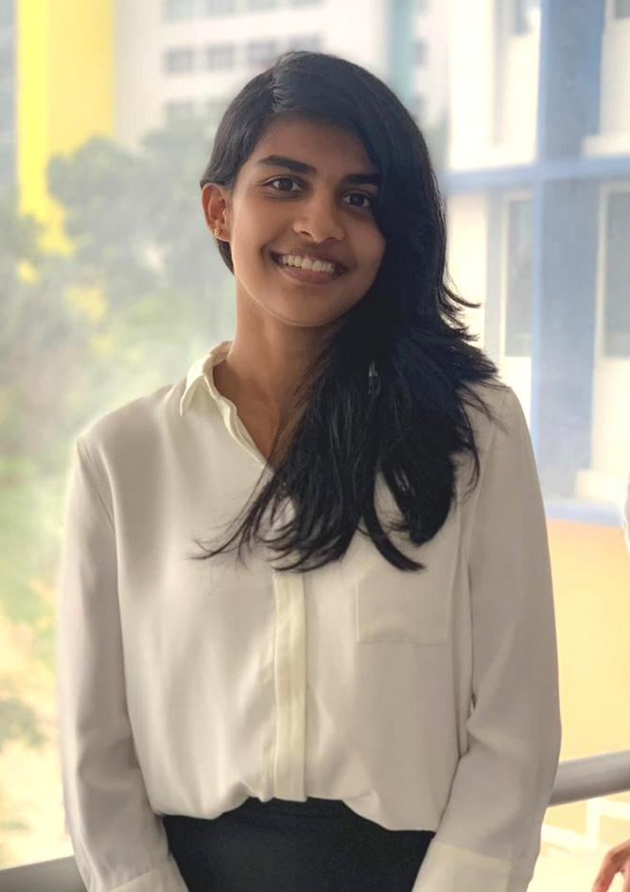
IT18119718 |Liyanage D.r.y
Information Technology
IT18119718 | Liyange D. R. Y. | 2021-073

Slide 57
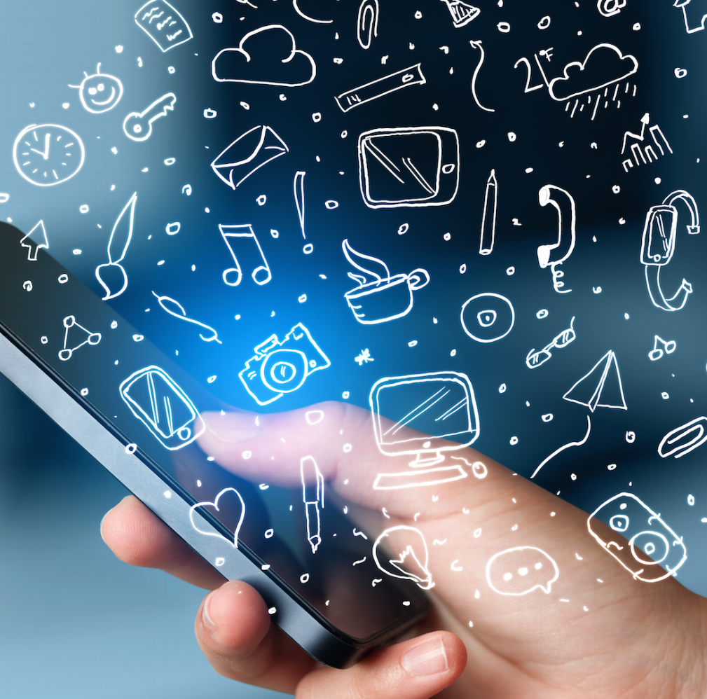
PHONE USAGE PATTERN ANALYSIS TO EARLY IDENTIFICATION OF DEPRESSIVE DISORDER
Research Question
Specific and Sub Objectives
Evidences for the Completion
IT18119718 | Liyange D. R. Y. | 2021-073

Slide 58
Research Question
Lack of the automated applications that focus on identify early depression disorder using Phone usage data.
Two-week manual monitoring of individual difficulty.
Lack of systems that acquire data without the user’s contribution.
Individuals tend to avoid medications due to the negative impact on society.
IT18119718 | Liyange D. R. Y. | 2021-073

Slide 59


Research Gap
 | [31] [32] [33] | [34] | [35] | [36] | Proposed System
Depression analysis based on phone usage pattern.
Collect data without user contribution for the analysis.
Explore the key factors that links depresion.
Probability of early depression analysis based on phone usage pattern data.
IT18119718 | Liyange D. R. Y. | 2021-073

Slide 60
Mobile Application Gap
 | PROSIT | App Usage | TypeOf Mood app | Proposed App
Track parameters most related to depression
Collect data without user collaboration
Depression analysis based on Phone usage data
Notify Guardian
Comprehensive report Summary
IT18119718 | Liyange D. R. Y. | 2021-073

Slide 61
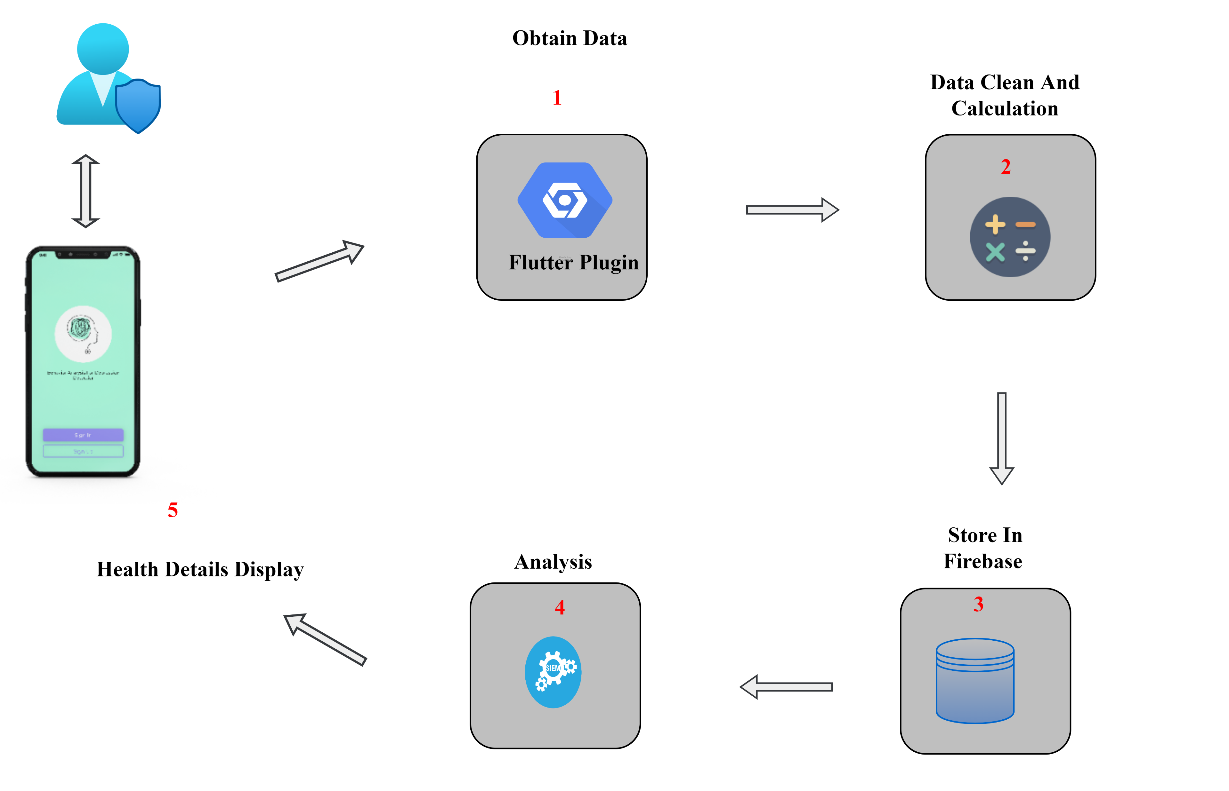
System Overview
IT18119718 | Liyange D. R. Y. | 2021-073

Slide 62
Specific and Sub Objectives
Specific Objective
Identify the individuals that in the lead to depression disorder based
on their phone usage pattern changes.
Sub Objectives
Recognize the key factors of phone usage to identify depressive disorder changes.
Build a service to run in the mobile in order to log the key factor’s data.
Based on data build a classifier to model, abnormal phone use based on mobile phone usage
Predict the probability of abnormal phone use towards depression with the designed model.
Integrate the classifier to the mobile app
IT18119718 | Liyange D. R. Y. | 2021-073
IT18119718 | Liyange D. R. Y. | 2021-073

Slide 63
Implementation Progress
Data Collecting
Data Analyzing
Model Implementation & Deploy
Access Phone Usage
Implement API to Identify App Category
Separate and store App Details
App detail calculation and rendering
Data Labeling
Data preprocessing
Model accuracy Testing
API Implementation
API Testing
Deploy in server
Access Method
Clean accessed Data
API Implementation
Test API
Deploy API in server
Completed
Integrate Category API with APP
App detail
Arranging
Store in firebase
To be Completed (PP2)
To be Completed (Final)
IT18119718 | Liyange D. R. Y. | 2021-073

Slide 64
Implementation Progress
Model Integration with app
Individual components integration
Mobile App Integration
API end point access
Output the prediction
UI Implementation
Complete the Individual Component
Testing
Complete UI
Functionality Testing
Final Testing
Completed
To be Completed (PP2)
To be Completed (Final)
IT18119718 | Liyange D. R. Y. | 2021-073

Slide 65
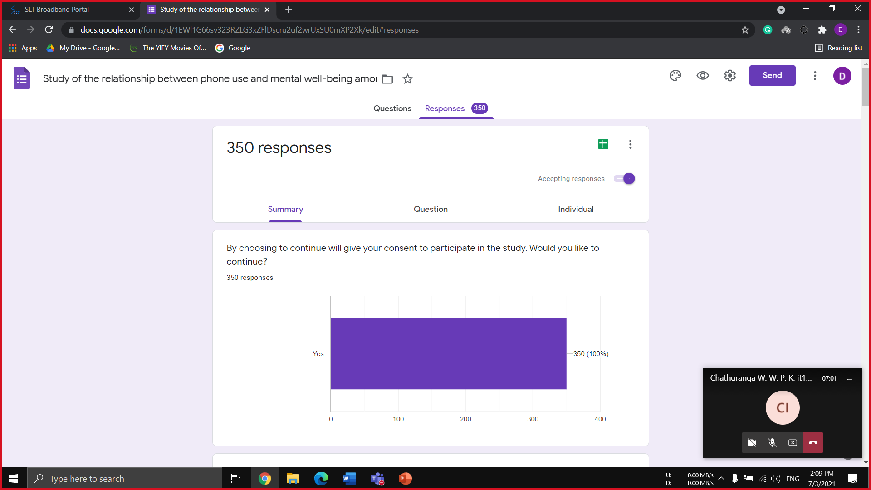
Data Collection
Data Collected through questionnaire according to phycological standard
Individuals: 350
Individual’s Age Range : 16 – 30
IT18120226 | Oshadi Yashodhika G. B. | 2021-073

Slide 66
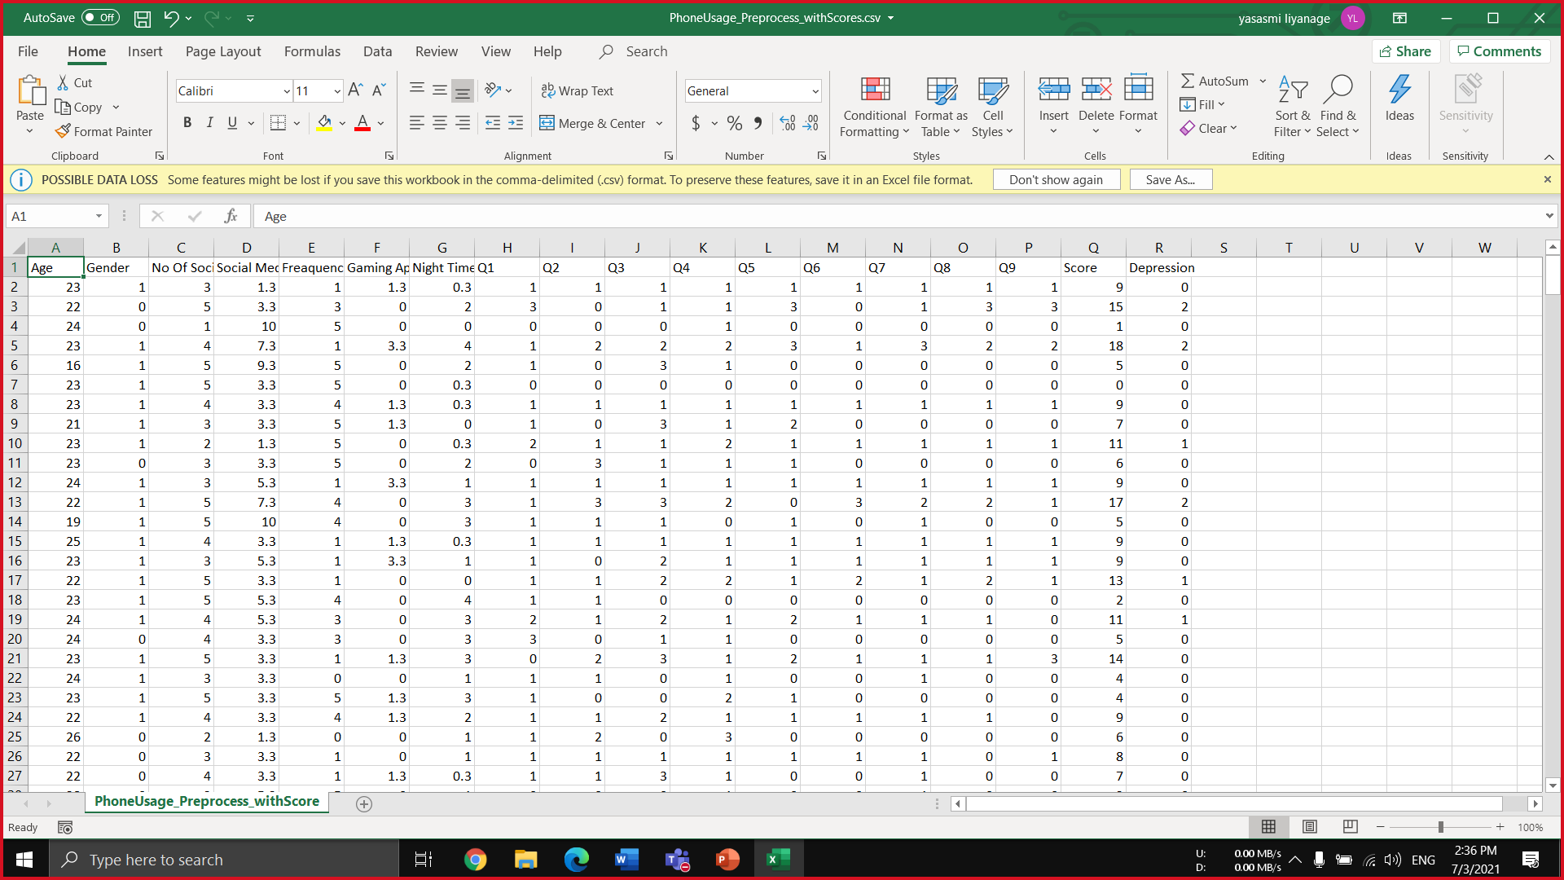
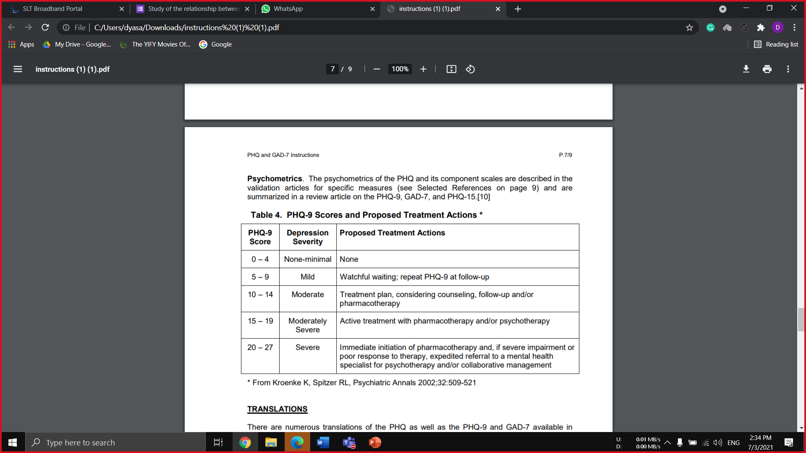
Data Analysis
Data Labeling
The data Have been Labeled according to the world standards.
Standard: PHQ-9 Scores and Proposed Treatment Actions
Guidance: Clinical Psychologist (External supervisor )
Data Preprocessing
Clean data: Remove Rows with Missing Values, Encoding
Categorizing: Identify the Depression levels according to PHQ-9 Scores
Depressed Individuals – 100 (Mild: 62 / Moderate:27 / severe: 11)
IT18119718 | Liyange D. R. Y. | 2021-073

Slide 67
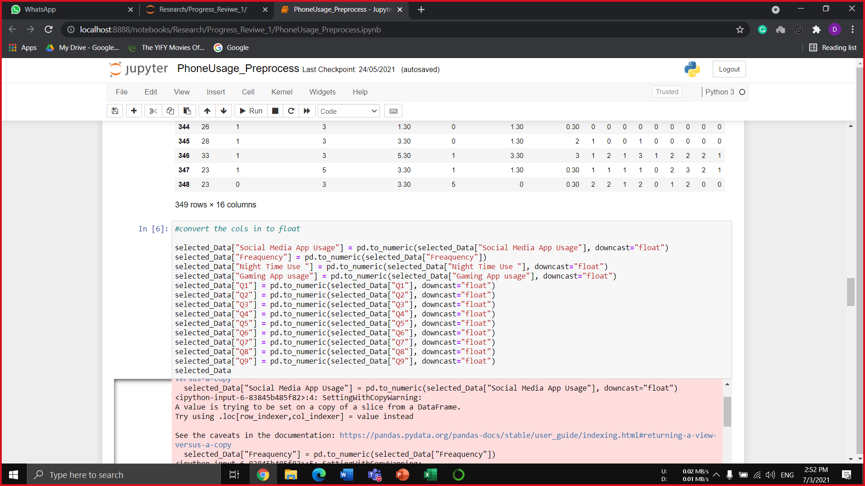
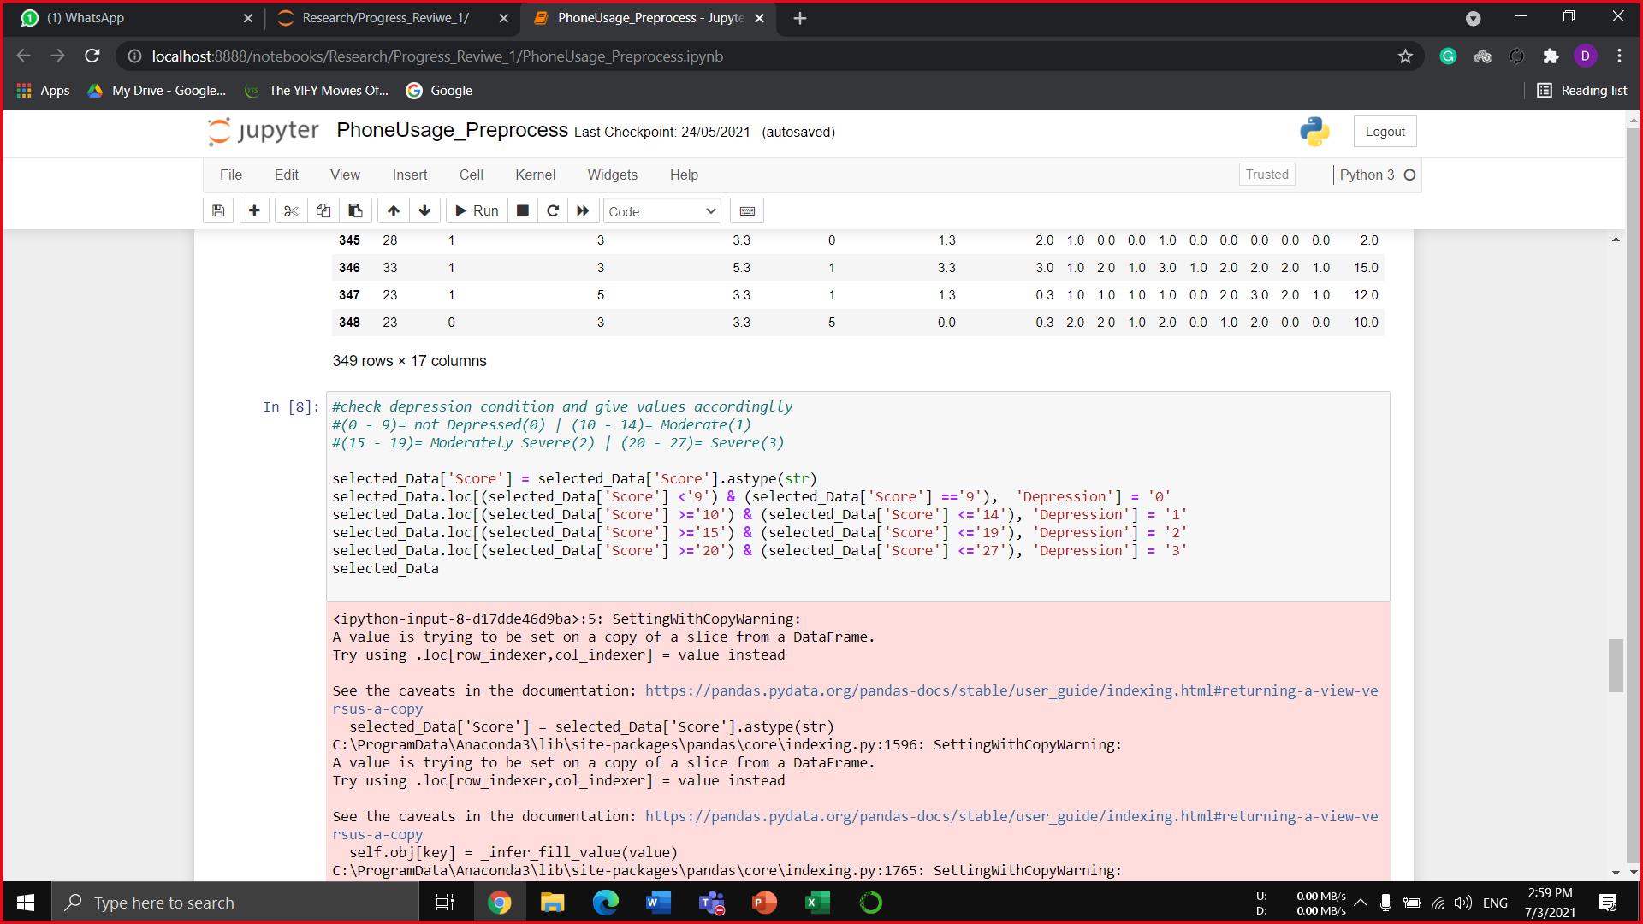
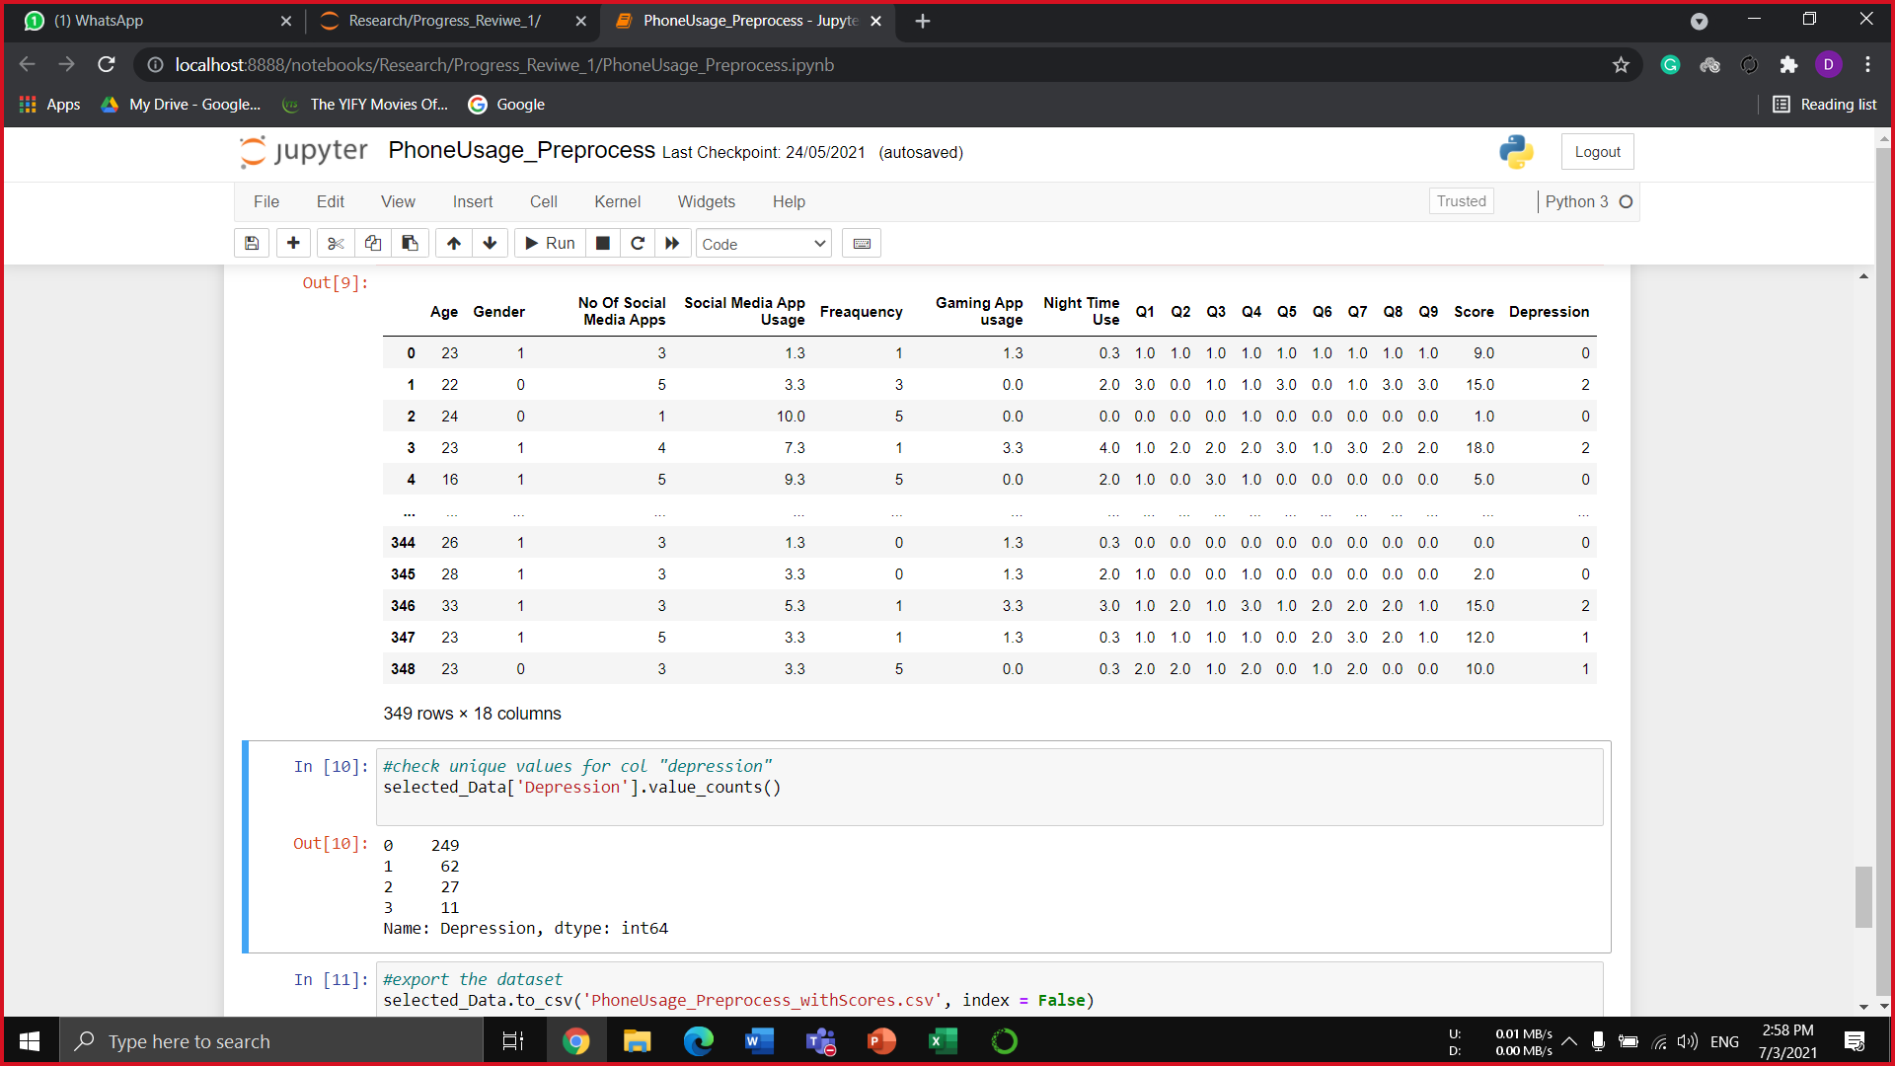
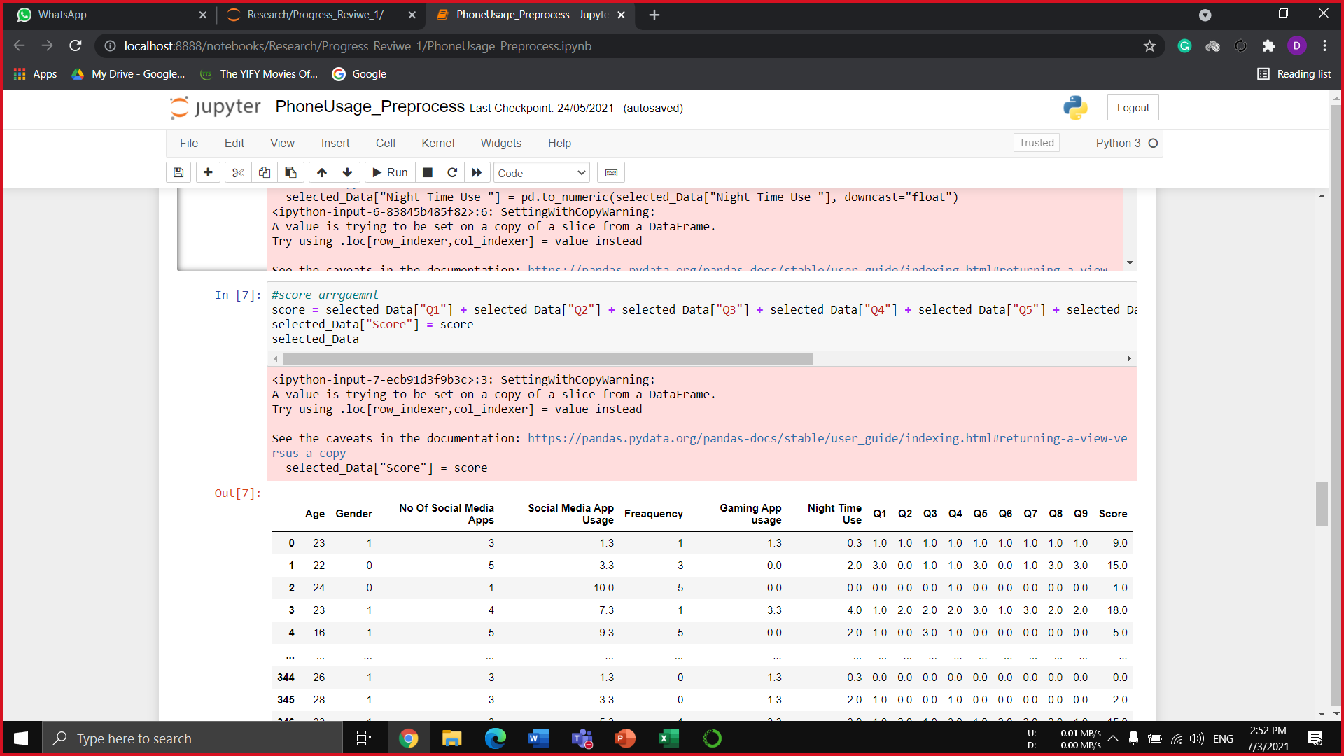
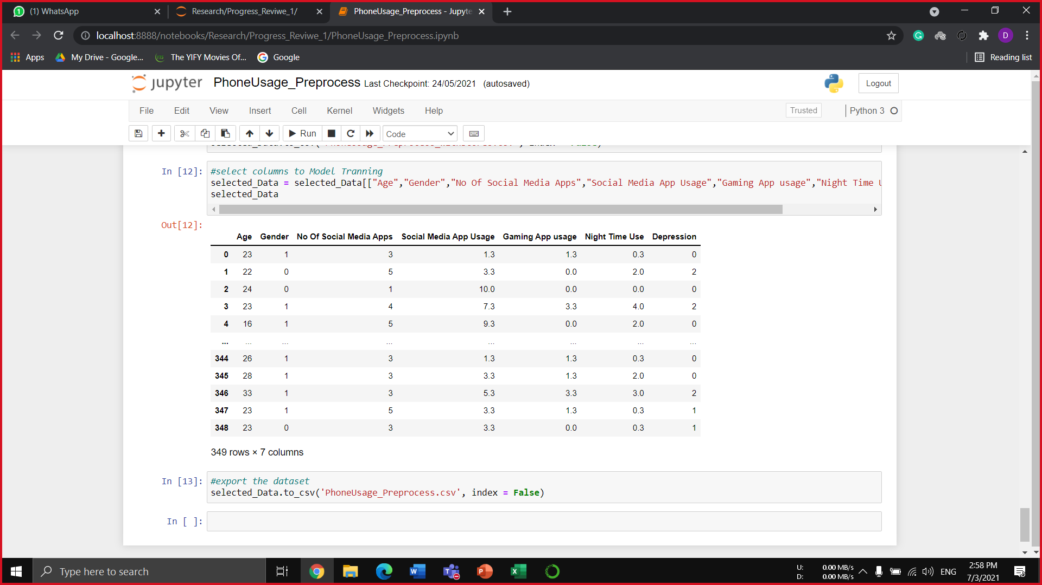
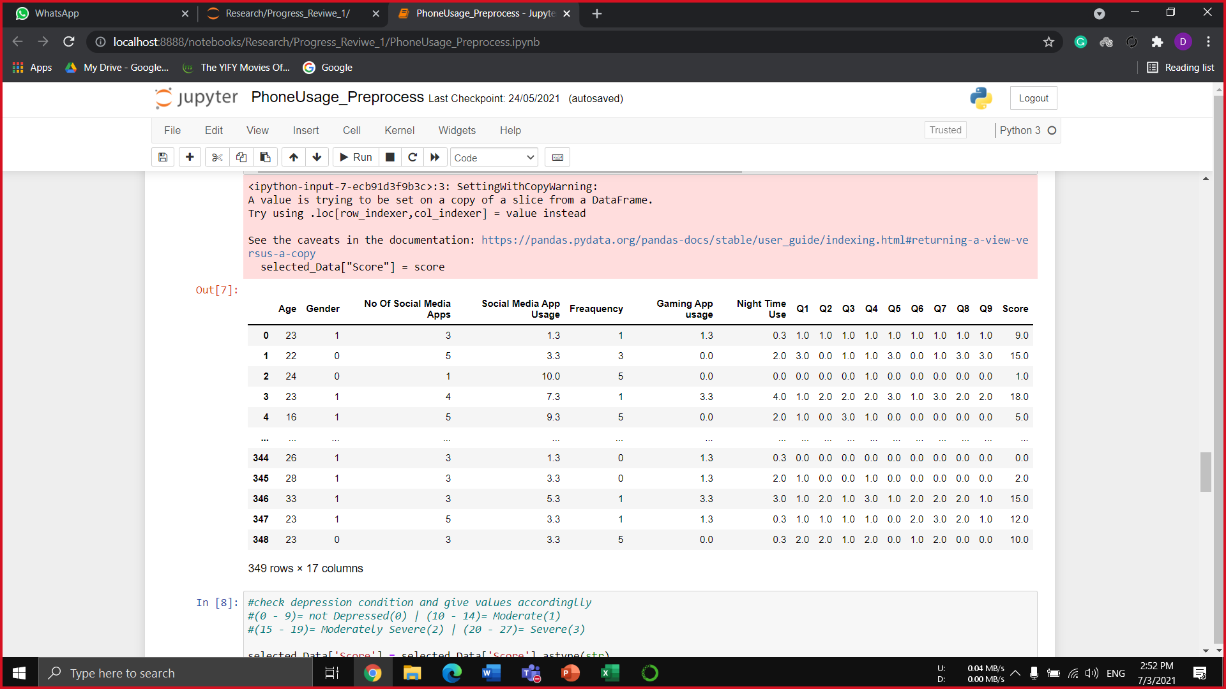
Data Analysis (Cont’d)
Data Preprocessing
IT18119718 | Liyange D. R. Y. | 2021-073

Slide 68
Model Implementation
Model Implementation
Model have been Implemented with supervised learning classification Algorithms.
k-nearest neighbors (KNN) algorithm : Accuracy at k = 15 → 75%
Support Vector Machine (SVM) algorithm : Accuracy for kernel = poly with degree = 3 → 67%
Random Forest algorithm: Accuracy → 58%
Naive Bayes algorithm: accuracy → 76%
From The Best Accuracy model KNN Pickle file have been separated for API purposes.
IT18119718 | Liyange D. R. Y. | 2021-073

Slide 69
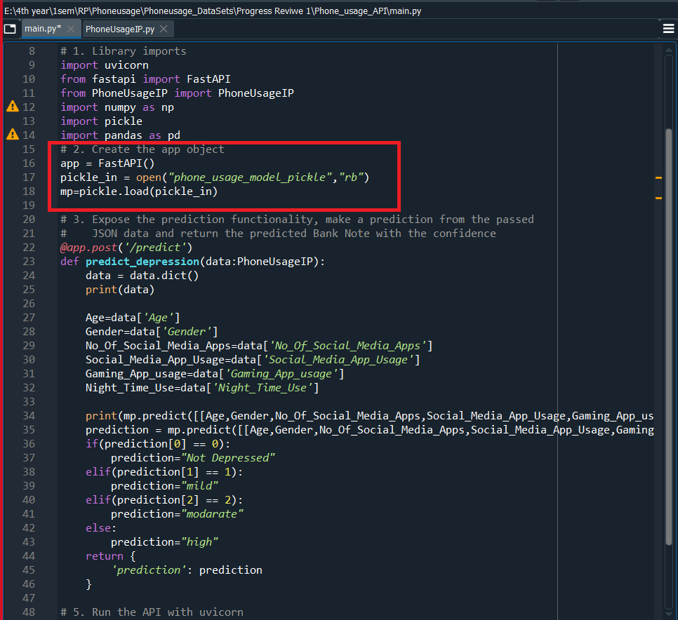
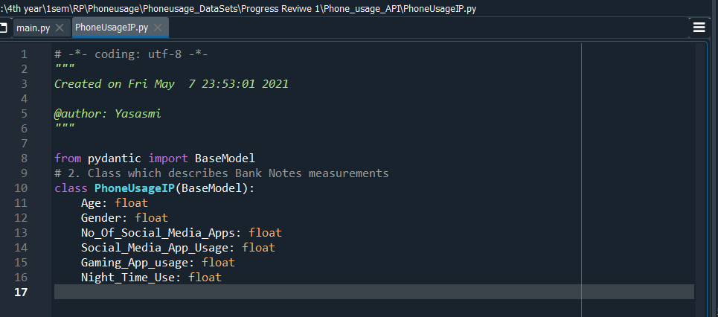
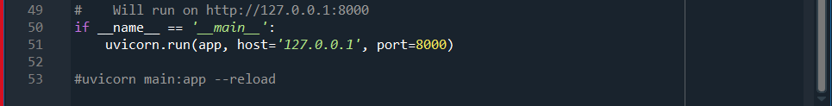
Model Implementation.(Cont’d)
Model API Implementation.
Using the Model Pickle file write an API for access the model in Mobile Application.
Methods used: Python Fast API
Purpose : In order to Pass phone usage parameters and acquire the Prediction.
API Deploy In server
The implemented API has been deployed in the server for secure accessibility .
Server: Deployed in Heroku
API Testing.
Used Swagger to test the API .
Import Pickle File
IT18119718 | Liyange D. R. Y. | 2021-073

Slide 70
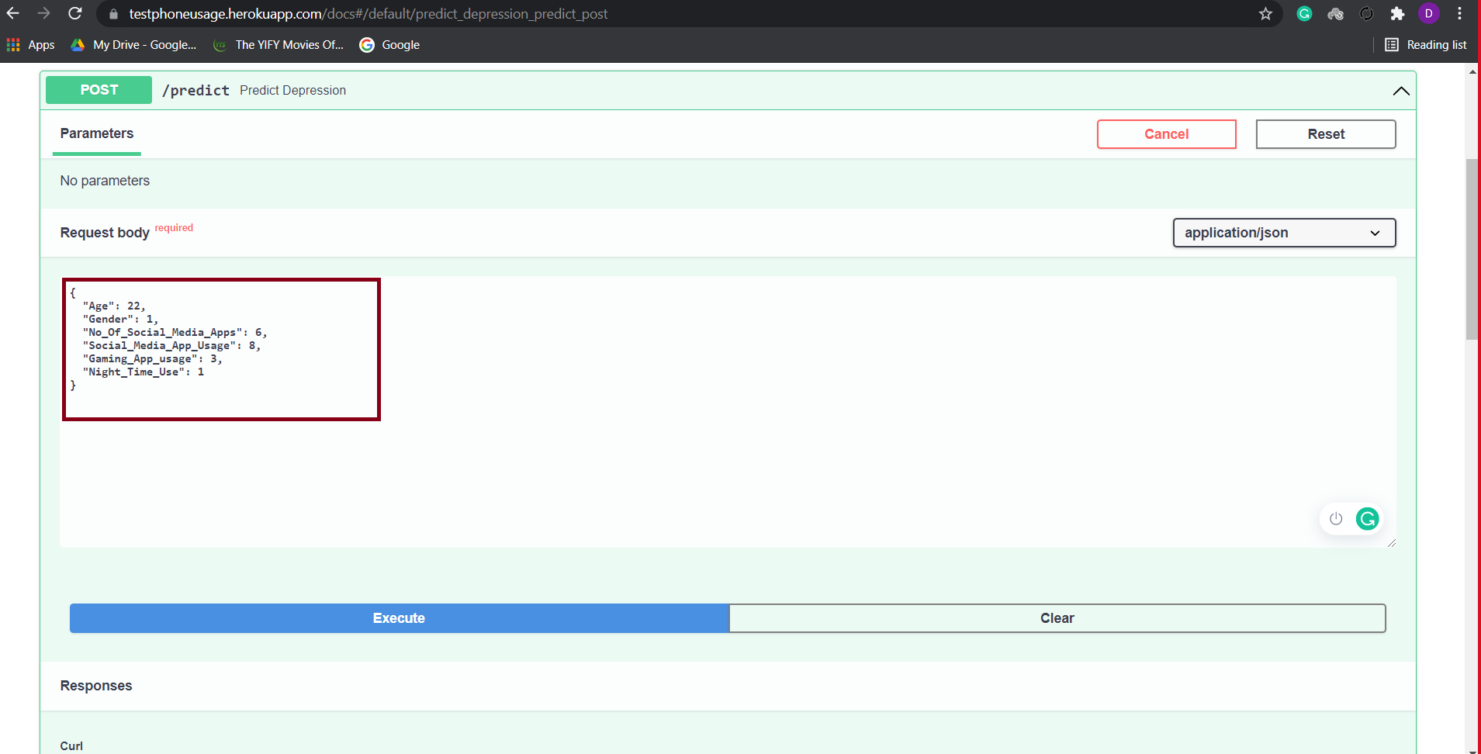



Model Implementation and Deploy (Cont’d)
API Deploy (Heroku)
API Testing (Swagger)
IT18119718 | Liyange D. R. Y. | 2021-073

Slide 71
API Implementation To identify App Category
API Implementation
To Identify the categories of the mobile apps, required to implement a Method .
Issue : There was No recourses to apply in order to identify the app category.
Solution : Implemented an API to identify app category.
Method: according to the package name of the mobile app Access google Play store Browser HTML selector and get the category for this process implemented an API.
Framework use to implement : Laravel
Library: crawler
IDE: PhpStorm
Deploy And Test API.
The API is Deployed for Accessing through flutter app and Tested for ensure the process.
Deployed : Heroku
Test: Postman.
IT18119718 | Liyange D. R. Y. | 2021-073

Slide 72

API Implementation To identify App Category (Cont’d)
Copy The selector Path for use in the API Implantation
IT18119718 | Liyange D. R. Y. | 2021-073

Slide 73

API Implementation To identify App Category (Cont’d)
Pass the Package name of the APP To the URL
Selector Path Copied from Google Play Store Browser
IT18119718 | Liyange D. R. Y. | 2021-073

Slide 74



API Implementation To identify App Category (Cont’d)
API Deploy (Heroku)
API Testing (Postman)
Get The Category As Json Response
Pass Package Name with URL
IT18119718 | Liyange D. R. Y. | 2021-073

Slide 75


Mobile Implementation.
Accessing The Phone Usage
In order to Access the App Usage Data Of the user have used the Flutter Package.
Package → app_usage:1.2.0
Minimum SDK for the Package → 21
Language: Flutter and Dart
Package
Minimum SDK Version
IT18119718 | Liyange D. R. Y. | 2021-073

Slide 76


Mobile Implementation.
Clean accessed Data.
The Data retrieving from the package is not readable, So we need to Go with some steps to make them Readable.
Before Clean
After Clean
IT18119718 | Liyange D. R. Y. | 2021-073

Slide 77

Mobile Implementation.
APP categorizing API integration and Calculation.
The cleaned data have categorized in to the social and gaming apps using the impended API .
Calculation have conducted to get number of hours using Social apps, Gaming apps, night usage, total usage and NO.of Social apps.
Integrate and Arrange The Used Apps
Integrate The API
Integrate The API
IT18119718 | Liyange D. R. Y. | 2021-073

Slide 78

Mobile Implementation.
Arrange The Used Apps
Apps Total duration
Arrange in to Social and gamming app and system apps and other apps will be ignored
IT18119718 | Liyange D. R. Y. | 2021-073

Slide 79


Mobile Implementation.
Integrate and Arrange The Used Apps
Firebase Integration and Store Data.
The Arranged data have store in the firebase.
Integrate The API
Firebase Packages and Files
Stored data in Firebase
IT18119718 | Liyange D. R. Y. | 2021-073

Slide 80

Mobile Implementation.
14 days analysis calculation.
The stored data have accessed, and calculations have conducted for get 14days average usage data.
Integrate The API
14 Days Calculation
IT18119718 | Liyange D. R. Y. | 2021-073

Slide 81

Mobile Implementation.
Modal API Integration.
Implemented model API integrated to the mobile application for analysis.
The 14 days calculated average data pass to API for analysis.
Integrate The API
Integrate The API
IT18119718 | Liyange D. R. Y. | 2021-073

Slide 82

Mobile Implementation.
Front end design and data Rendering.
The calculated summary have passed to the front end.
Integrate The API
Code segments to use arrange and render Out puts
IT18119718 | Liyange D. R. Y. | 2021-073

Slide 83



Phone Usage Analysis Summary
Phone usage analysis Total Phone usage summary 14 days usage monitoring
IT18119718 | Liyange D. R. Y. | 2021-073

Slide 84

Work Breakdown Structure
IT18119718 | Liyange D. R. Y. | 2021-073

Slide 85


Individual Progress
→ Model Implementation.
→ Mobile App Implementation.
→ Individual components Integration.
Progress To Be
→ System Integration.
Current Progress
IT18120226 | Oshadi Yashodhika G. B. | 2021-073
IT18119718 | Liyange D. R. Y. | 2021-073

Slide 86
References
[31] K. Demirci, M. Akgönül and A. Akpinar, "Relationship of smartphone use severity with sleep quality, depression, and anxiety in university students," Journal of Behavioral Addictions, vol. 4, no. 2, pp. 85-92, 2015.
[32] A. Višnjić, V. Veličković, D. Sokolović, M. Stanković, K. Mijatović, M. Stojanović, Z. Milošević and O. Radulović, "Relationship between the Manner of Mobile Phone Use and Depression, Anxiety, and Stress in University Students," International Journal of Environmental Research and Public Health, vol. 15, no. 4, p. 697, 2015.
[33] S. Thomée, A. Härenstam and M. Hagberg, "Mobile phone use and stress, sleep disturbances, and symptoms of depression among young adults - a prospective cohort study," 2020.
[34] E. Hoare, K. Milton, C. Foster and S. Allender, "Depression, psychological distress and Internet use among community-based Australian adolescents: a cross-sectional study," BMC Public Health, vol. 17, no. 1, 2017.
[35] Chowdhry , "Research Links Heavy Facebook And Social Media Usage To Depression," 2017.
[36] R.-E. Mastoras, D. Iakovakis, S. Hadjidimitriou, V. Charisis, S. Kassie, T. Alsaadi, A. Khandoker and L. J. Hadjileontiadis, "Touchscreen typing pattern analysis for remote detection of the depressive tendency," Scientific Reports, no. 1, 2019.
IT18119718 | Liyange D. R. Y. | 2021-073

Slide 87

IT18119572 |ChathurAnga W.W.P.K
Information Technology
IT18119572 | Chathuranga W. W. P. K. | 2021-073

Slide 88

INVASIVE & NON – INVASIVE METHODS TO EARLY IDENTIFICATION OF DEPRESSIVE DISORDER
Research Question
Specific and Sub Objectives
Evidences for the Completion
IT18119572 | Chathuranga W. W. P. K. | 2021-073

Slide 89
Research Question
Lack of the automated applications that focus on identify early depression disorder using both invasive and non - invasive methods.
Lack of systems that acquire data without the user’s contribution.
Difficulties of two weeks manual monitoring individuals.
The social impact that makes individuals avoid medication and understand symptoms.
IT18119572 | Chathuranga W. W. P. K. | 2021-073

Slide 90
Research Gap
 | [37] | [38] | [39] | [40] | Proposed System
Depression analysis base on biometrical parameter changes.
Screen and track depression using data that acquired using wearable
Explore which data can be collected using a wearable to predict depression.
Invasive method to acquire parameter data
Noninvasive method as an alternative to acquire same parameter data.
Probability of early depression analysis based on biometric data.
IT18119572 | Chathuranga W. W. P. K. | 2021-073

Slide 91
Mobile Application Gap
 | Sleepio | StressScan | Welltory | Mood path | Proposed App
Track most critical factors Biomatrix data
Invasive method to collect Factor’s data
Non- invasive method to collect Factor’s data
Depression analysis based on Biomatrix data (HRV, Sleep pattern)
Notify Guardian
Comprehensive report Summary
IT18119572 | Chathuranga W. W. P. K. | 2021-073

Slide 92

System Overview
IT18119572 | Chathuranga W. W. P. K. | 2021-073

Slide 93
Specific and Sub Objectives
Specific Objective
Acquire invasive and non-invasive data analysis for early identification
of depressive disorder.
Sub Objectives
Recognize health parameters that can be collected using a wearable device to identify early depression symptoms.
Identify techniques as alternative methods to collect the same parameter data.
Collect data using invasive (wearable) and non-invasive techniques and build methods to identify early depression symptoms
Predict the probability of abnormal physical changes towards depression with the designed models.
Integrate both models into the mobile app.
IT18119572 | Chathuranga W. W. P. K. | 2021-073

Slide 94
Implementation Progress
Obtain Data
Data preprocessing
Model Implementation & Deploy
Invasively Data access using Wearable
Invasive Data Modifying and calculation
Rendering the Data
Invasive Model Integration with app
Model accuracy Testing
API End point
API Testing
Deploy in server
Google fit Authorization
Connect Google Fit to app
Access and Rendering data
Clean data
Store in firebase
Completed
API end point access
Output the prediction
To be Completed (PP2)
To be Completed (Final)
IT18119572 | Chathuranga W. W. P. K. | 2021-073

Slide 95
Implementation Progress
Non - Invasively Data access using mobile phone Sensors
Convert Accelerometer Data to sleep Data
Non- Invasive Data Modifying and calculation
Store and rendering the data
Non - Invasive Model Integration with app
Individual components integration
Mobile App Integration
Accelerometer Access
Phone camera and flasher access
Program Implementation
API Implementation
Testing
Deploy API in server
Clean data
Calculation
Store in firebase
API end point access
Testing
Output the prediction
Completed
Invasive & Non-Invasive integration
UI implementation
Complete Individual Component
Testing
To be Completed (PP2)
Complete UI
Functionality Testing
Final Testing
To be Completed (Final)
IT18119572 | Chathuranga W. W. P. K. | 2021-073

Slide 96
Obtain Data
The data have been collected Through Online Public database
Heart Rate data.
Parameters : Age, Gender, Heartrate
Total: 3798
Depressed Individuals: 483
Sleep Data
Parameters: Age, Gender, Total sleep, Ripped eye Moment Sleep (REM), Deep sleep, Light Sleep
Total: 530
Depressed Individuals: 71
IT18120226 | Oshadi Yashodhika G. B. | 2021-073
IT18119572 | Chathuranga W. W. P. K. | 2021-073

Slide 97


Data Pre-Processing
Data Preprocessing
Select Necessary Columns .
Added Necessary headings.
Remove Rows with Missing Values
Encoding
Data Categorizing
Select Necessary Columns
and
Give Headings
IT18119718 | Liyange D. R. Y. | 2021-073
IT18119572 | Chathuranga W. W. P. K. | 2021-073

Slide 98





Data Pre-Processing
Categorizing , Null Value Removing (Heart rate & Sleep data)
IT18119572 | Chathuranga W. W. P. K. | 2021-073
IT18119718 | Liyange D. R. Y. | 2021-073

Slide 99
Model Implementation and Deploy
Model Implementation
Models have been Implemented with supervised learning classification Algorithms.
Heart Rate Models
k-nearest neighbors (KNN) algorithm : Accuracy at k = 5 → 0.8447368421052631
Support Vector Machine (SVM) algorithm : Accuracy for kernel = rbf → 0.868421052631579
Naive Bayes algorithm : 0.86
Sleep Models
k-nearest neighbors (KNN) algorithm : Accuracy at k = 5 → 0.9528301886792453
Support Vector Machine (SVM) algorithm : Accuracy for kernel = poly with degree = 2 → 0.9433962264150944
Naive Bayes algorithm : 0.92
From The Best Accuracy models Pickle files have been separated for API purposes.
IT18119718 | Liyange D. R. Y. | 2021-073
IT18119572 | Chathuranga W. W. P. K. | 2021-073

Slide 100
Model Implementation and Deploy
Model API Implementation.
Using the Model Pickle files write APIs’ for access the model in Mobile Application.
Methods used: Python Fast API
Purpose : In order to Pass phone usage parameters and acquire the Prediction.
Two API Implementation Have been Done for best Sleep Model and Heart rate model.
API Deploy In server
The implemented APIs’ have been deployed in the server for secure accessibility .
Server: Deployed in Heroku
API Testing.
Used Swagger to test the APIs’.
IT18119718 | Liyange D. R. Y. | 2021-073

Slide 101


Model API Implementation and Deploy (Cont’d)
Heart Rate API Implementation
Import Pickle File
IT18119572 | Chathuranga W. W. P. K. | 2021-073
IT18119718 | Liyange D. R. Y. | 2021-073

Slide 102


Model API Implementation and Deploy (Cont’d)
Sleep API Implementation
Import Pickle File
IT18119718 | Liyange D. R. Y. | 2021-073
IT18119572 | Chathuranga W. W. P. K. | 2021-073

Slide 103




Model Implementation and Deploy (Cont’d)
Heart Rate API Deploy (Heroku)
Heart Rate API Testing (Swagger)
IT18119718 | Liyange D. R. Y. | 2021-073
IT18119572 | Chathuranga W. W. P. K. | 2021-073

Slide 104




Model Implementation and Deploy (Cont’d)
Sleep API Deploy (Heroku)
Sleep API Testing (Swagger)
IT18119718 | Liyange D. R. Y. | 2021-073
IT18119572 | Chathuranga W. W. P. K. | 2021-073

Slide 105
Convert The Accelerometer data to Sleep pattern
Program Implementation.
A python Program have Implemented to convert the Accelerometer data to sleep parameter
The Package Called “SleepPy” Have Been Modified and used.
Deep Sleep, Light Sleep, Total sleep
API Implementation .
For The Purpose of integrate the Python program to Mobile app, Implemented an API.
Accelerometer data CSV must be pass to the API.
Deploy and Test API
The API is Deployed for Accessing through flutter app and Tested for ensure the process.
Deployed : Heroku
Test: Postman.
IT18119718 | Liyange D. R. Y. | 2021-073
IT18119572 | Chathuranga W. W. P. K. | 2021-073

Slide 106


Python Program Implementation.
Code Segment Of python Program
IT18119718 | Liyange D. R. Y. | 2021-073
IT18119572 | Chathuranga W. W. P. K. | 2021-073

Slide 107

API Implementation.
IT18119718 | Liyange D. R. Y. | 2021-073

Slide 108



API Deploy and Test.
Post Request
Deploy In Heroku
Pass the CSV file As Content Type = “multipart/Form-data”
Json Response.
IT18119718 | Liyange D. R. Y. | 2021-073
IT18119572 | Chathuranga W. W. P. K. | 2021-073

Slide 109
Mobile Implementation (Invasive)
Invasively access Using Wearable
A Wearable has been used to access the User Heart rate and Sleep Pattern data.
Used Wearable: MI Band 5
Accessed Method: Connectivity of Google FIT account.
App Side development: Flutter FIT KIT Package
Google Fit Authorization.
In order to integrate the Google Account To the mobile app there is a processes to follow.
Create a project in Google cloud platform.
Install the google fit kit library to the created project.
Create a Client id for android in the project.
IT18119718 | Liyange D. R. Y. | 2021-073
IT18119572 | Chathuranga W. W. P. K. | 2021-073

Slide 110




Mobile Implementation (Invasive)(Cont’d)
MI band 5
FIT KIT Package Integration with Flutter App
Google FIT Account
IT18119718 | Liyange D. R. Y. | 2021-073
IT18119572 | Chathuranga W. W. P. K. | 2021-073

Slide 111



Mobile Implementation (Invasive)(Cont’d)
Google Fit Authorization Step
1
3
2
IT18119718 | Liyange D. R. Y. | 2021-073
IT18119572 | Chathuranga W. W. P. K. | 2021-073

Slide 112

Mobile Implementation (Invasive)
Render The data
After The Google fit process as well as the Integration with APP Render the data.
We only access the Sleep Pattern data and Heart rate data.
IT18119718 | Liyange D. R. Y. | 2021-073

Slide 113

Mobile Implementation
After Clean the data
Before Clean the data
IT18119572 | Chathuranga W. W. P. K. | 2021-073

Slide 114
Mobile Implementation (Non - Invasive)
Accelerometer access .
The Accelerometer is accessed to collected to detect the orientation of the phone (Time Stamp, X Y Z).
The Accelerometer data will be converting in sleep parameters using Implemented Python Program.
Phone Camera and Flasher Access.
The Phone Camera and flasher is accessed to collect heart rate from the user.
The heart rate can be directly accessible with this method.
IT18119718 | Liyange D. R. Y. | 2021-073
IT18119572 | Chathuranga W. W. P. K. | 2021-073

Slide 115


Accelerometer Access .
Out Put
Time stamp
X
Y
Z
Accelerometer access Integration
IT18119718 | Liyange D. R. Y. | 2021-073
IT18119572 | Chathuranga W. W. P. K. | 2021-073

Slide 116



Phone Camera and Flasher access .
Phone Camera and Flasher access Integration
Out Put
Heart Rate
User Need to cover Both camera and Flash With a finger
IT18119572 | Chathuranga W. W. P. K. | 2021-073

Slide 117


Mobile Implementation (Non - Invasive)
Convert The Accelerometer data to Sleep pattern API Integration
The Implemented API have Integrated to the mobile application for get sleep patten data
API Integration
Accelerometer CSV Create and Pass
IT18119718 | Liyange D. R. Y. | 2021-073
IT18119572 | Chathuranga W. W. P. K. | 2021-073

Slide 118



Mobile Implementation (Cont’d) .
Store data in Firebase
Invasively and non - invasively obtained and calculated data stored in the firebase.
Firebase Packages and Files
Firebase data Access
Stored data in Firebase
IT18119718 | Liyange D. R. Y. | 2021-073
IT18119572 | Chathuranga W. W. P. K. | 2021-073

Slide 119

Mobile Implementation.
14 days analysis calculation.
The stored data have accessed, and calculations have conducted for get 14days average usage data.
Integrate The API
14 Days Calculation
IT18119572 | Chathuranga W. W. P. K. | 2021-073

Slide 120
Mobile Implementation.
Modal API Integration.
Implemented model API integrated to the mobile application for analysis.
The 14 days calculated average data pass to API for analysis.
Integrate The API
Integrate The API
IT18119572 | Chathuranga W. W. P. K. | 2021-073

Slide 121


Mobile Implementation.
Front end data Rendering.
The calculated summary
have passed to the front end.
Integrate The API
Chart Rendering Codes
Front – end Rendering Codes
IT18119572 | Chathuranga W. W. P. K. | 2021-073

Slide 122






Invasive and Non – Invasive Analysis Summary
Invasive Sleep analysis
Invasive Heart rate analysis
14 days usage monitoring
Non-Invasive
Sleep analysis
Non-Invasive
Heart rate analysis
14 days usage monitoring
IT18119718 | Liyange D. R. Y. | 2021-073
IT18119572 | Chathuranga W. W. P. K. | 2021-073

Slide 123

Work Breakdown Structure
IT18119572 | Chathuranga W. W. P. K. | 2021-073

Slide 124
Individual Progress
→ Data Collection & Analysis.
Progress To Be
→ Model Implementation.
→ Mobile App Implementation of Invasive.
→ Noninvasive heart rate access, Accelerometer access
→ Convert accelerometer data to Sleep Patten.
→ API Implementation.
→Integrate Non-Invasive Part .
→Individual Component Integration.
Current Progress
→ System Finalizing
IT18113914 | De Silva L. S. R. | 2021-073
IT18119572 | Chathuranga W. W. P. K. | 2021-073

Slide 125
References
[37] Y. Tazawa, K.-c. Liang, M. Yoshimura, M. Kitazawa, Y. Kaise and A. Takamiya, "Evaluating depression with multimodal wristband-type wearable device: screening and assessing patient severity utilizing machine-learning," Heliyon, vol. 6, no. 2, 2020.
[] R38. Wang, W. Wang, A. daSilva, J. F. Huckins, W. M. Kelley, T. F. Heatherton and A. T. Campbell, "Tracking Depression Dynamics in College Students Using Mobile Phone and Wearable Sensing," Proceedings of the ACM on Interactive, Mobile, Wearable and Ubiquitous Technologies, vol. 2, no. 1, pp. 1-26, 2018.
[39] Ghandeharioun†, S. Fedor†, L. Sangermano, D. Ionescu, J. Alpert, C. Dale, D. Sontag and R. Picard, "Objective Assessment of Depressive Symptoms with," 2017
[40] I. Moshe, Y. Terhorst, K. O. Asare, L. B. Sander, D. Ferreira, H. Baumeister, C. M. David and L. Pulkki-Råback , "Predicting Symptoms of Depression," january 2021
IT18119572 | Chathuranga W. W. P. K. | 2021-073

Slide 126

Risk Mitigation
Identified Risks of the project
Risk Mitigation techniques Used

Slide 127
Risk Mitigation
Difficulties to visit hospitals for collecting data due to Covid -19 Pandemic.
Solution: Obtain validated datasets from internet.

Slide 128
Commercialization for Proposed System
How proposed system addresses identified concerns?
Community value.
Business plan.
Overall budget.

Slide 129
How proposed system address the identified concerns?
Concern | Solution
In Sri Lanka, people may obscure the state of their minds due to social stigma and fear. | Self awareness app that users can understand about their mental status
Mental health providers have problems with monitoring of individuals for two weeks. | Summary up to two weeks behavioral analysis notify user’s status.
Periodic assessment based on structured or unstructured clinical interviews may bias the different aspects of individuals. | Analysis of user behavioral changes without user contribution.
People are not receiving adequate treatments, which may lead to suicide. | User’s mental health status can be sharing with Mental health providers.

Slide 130


Overall budget
Event | $Cost (Rs)
MI band wristwatch | $30 – 32 (Rs. 6000 – 6250)
Create Play Store account to deploy the app | $25 (Rs.4875)
TOTAL | $57 (Rs. 11,115)

Slide 132



